Slide 1
Top 5 tips for Senior Students
Tim Barlow
Director of Technology Innovation
Notes:
Welcome.

Slide 2
Note Keeping and To-Do Lists
Notes:
Notes, to do lists

Slide 3
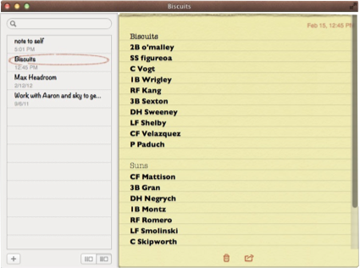
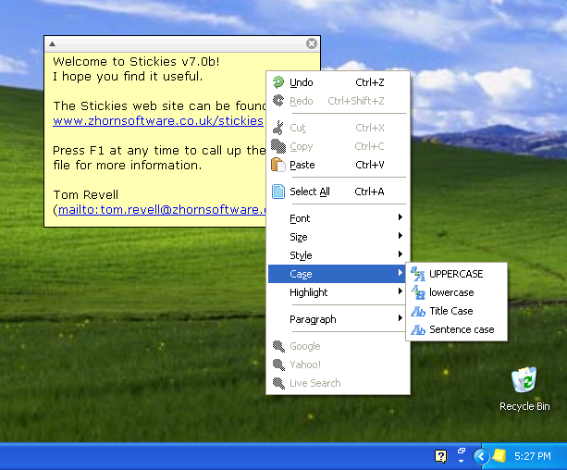
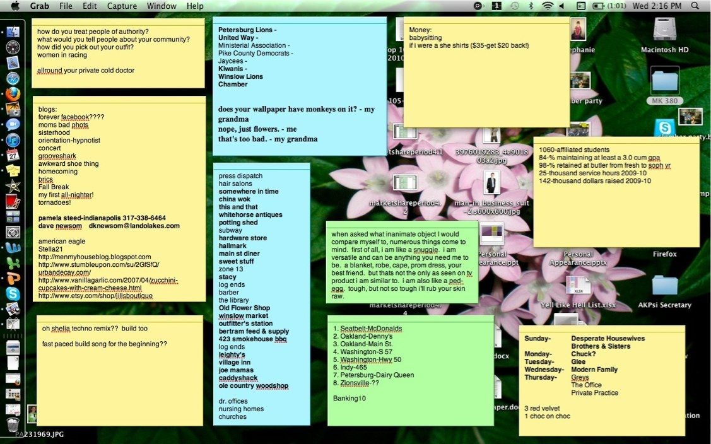
Notes
Notes:
Make a to do list for your day, week, month or just a constantly updated and prioritised list.
Many notes apps now sync across devices too so you can update on your phone and find it on your tablet or laptop.

Slide 4
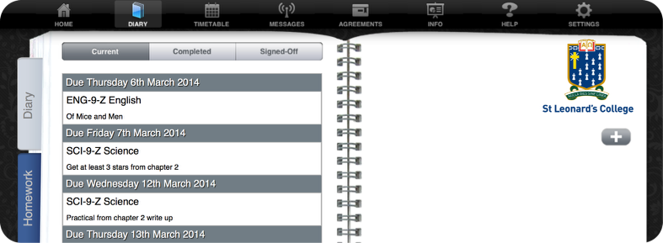
App4
http://stleonards.app4.ws/student/
Notes:
All students do have access to a school provided web based diary, to do list, timetable system in App4.
All parents can see their students diary too.

Slide 5
2. Maintaining Focus
Notes:
Prioritising

Slide 6
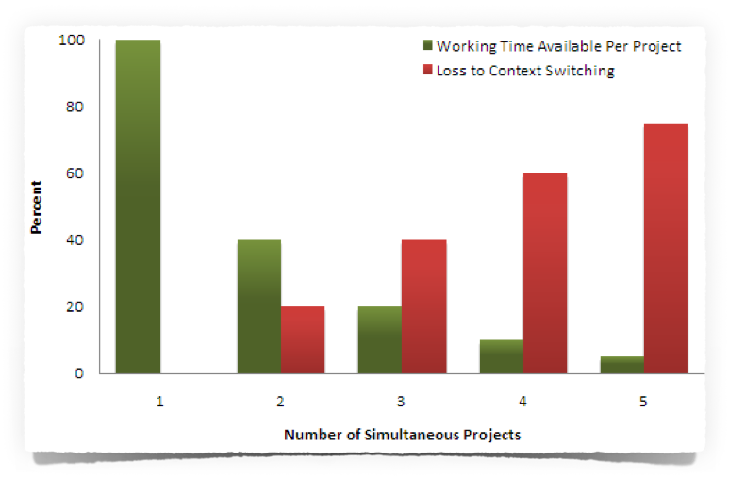
The Multitasking Myth
Notes:
Demo - ABC…, 123…, A1B2C3…
The human brain simply cannot multitask with even relatively simple cognitive things!
We can do cognitive things shortly after the other and this gives the illusion of multitasking. Unfortunately, each ‘task switch’ costs time and lots of task switching adds up to lots of time lost. With exams fast approaching it is time to apply your focus singularly.

Slide 7
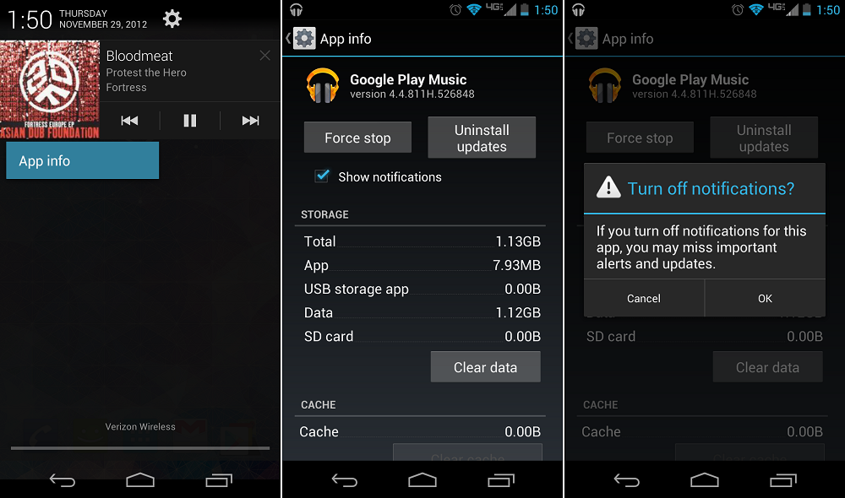
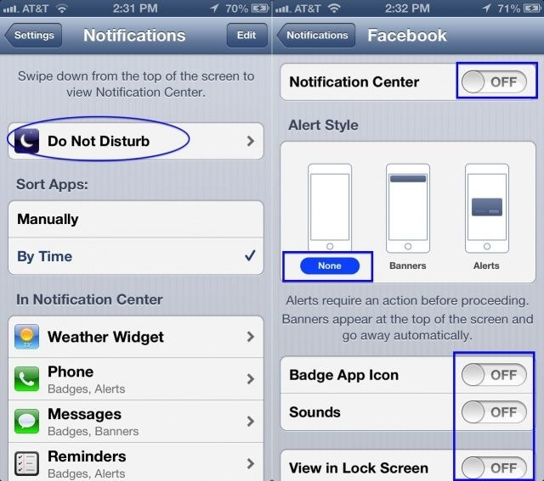
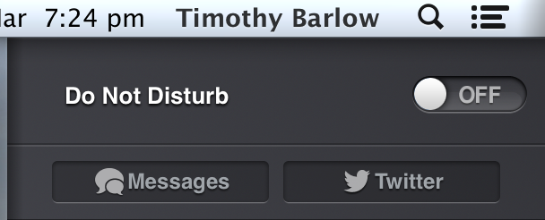
Turning notifications off
Notes:
This is one of the golden tips especially when we consider the multitasking myth.
Turn off notifications on the phone, tablet and laptop when studying.

Slide 8
3. Organisation, Storage
and Backing-up Your Work
Notes:
It is the student’s responsibility to maintain, store and back up all work and technological tools will be fundamental in this activity. Your success in school assessed course work and school assessed tasks depends greatly on your care and attention to creating and storing your work.

Slide 9
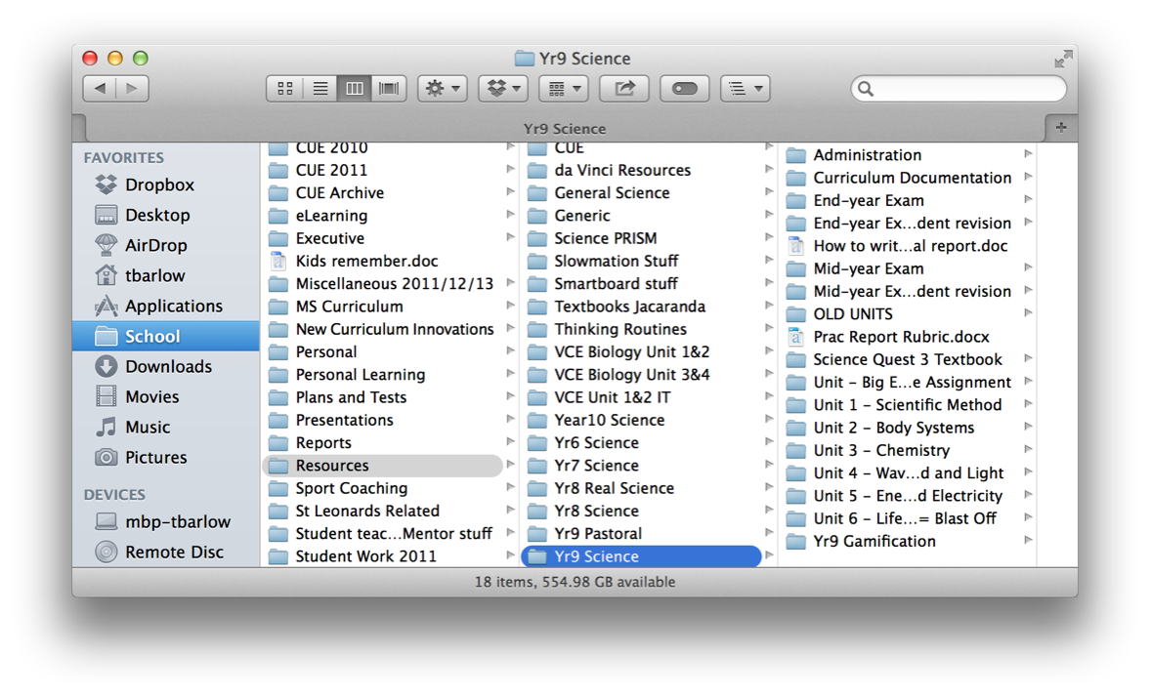
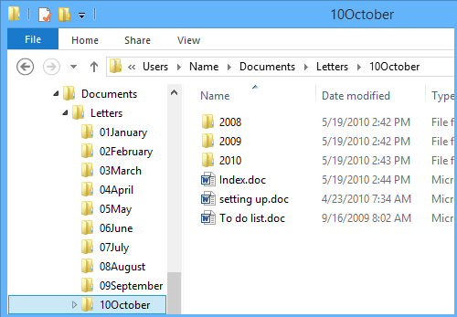
Files and Folders
Consistent naming.
Start with the year and month.
A folder for each subject with sub-folders.
Notes:
Make sure you name your files appropriately and store them in appropriate folders.
This kind of thing may sound obvious - but you’d be surprised how many students don’t do this.

Slide 10
Google Drive, iCloud, OneDrive or Dropbox
Notes:
Online document storage now offers a wealth of choice. And the free online productivity suites of software available from Apple, Google and Microsoft are very good.

Slide 11
4. Teacher Developed Resources
Notes:
STL Link Resources – your teacher’s notes and resources are essential components in your study practices, weekly and long-term.

Slide 12
Podcasts and YouTube
Notes:
Educational media can be a fantastic use of time when it comes to study. If your child finds themselves regularly in a situation where sitting down at a desk is impossible, they can still get great benefit from an audio podcast or video content. Staff may be able to direct students to content but also encourage students to find material that clicks with them. There is so very much stuff out there these days.

Slide 13
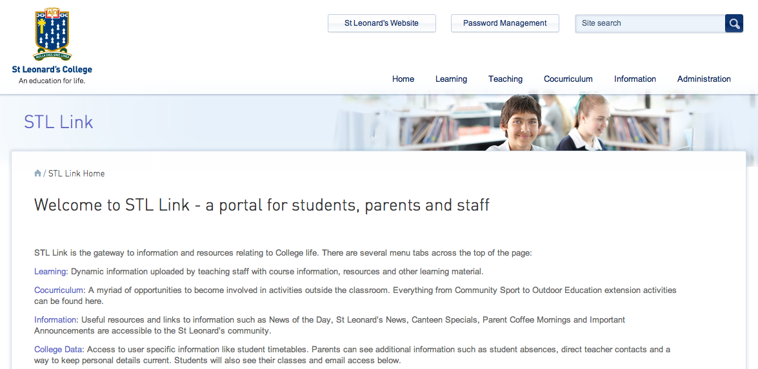
STL Link
Notes:
The teaching staff have, over the past year or so, created an absolute gold mine of educational resources like past exams. Students have been directed to this in their classes. This is a valuable first port of call for some study sessions.

Slide 14
5. Managing Dates and Deadlines
Notes:
Calendars are essential tools for time management during your busy year.

Slide 15
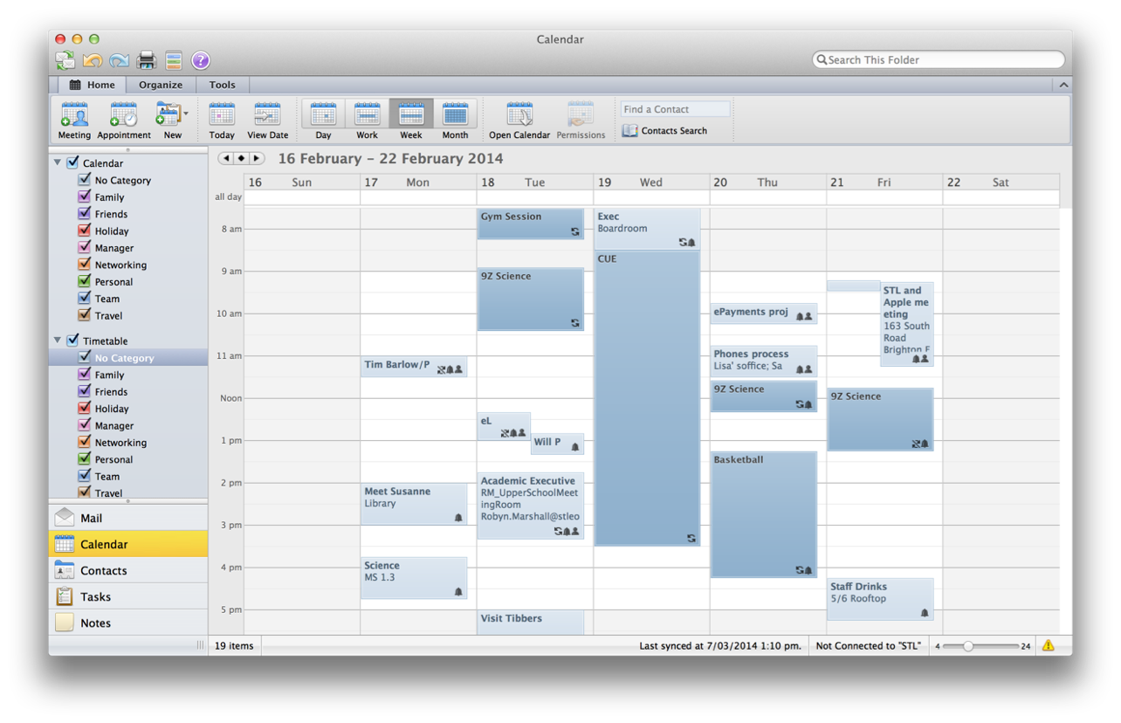
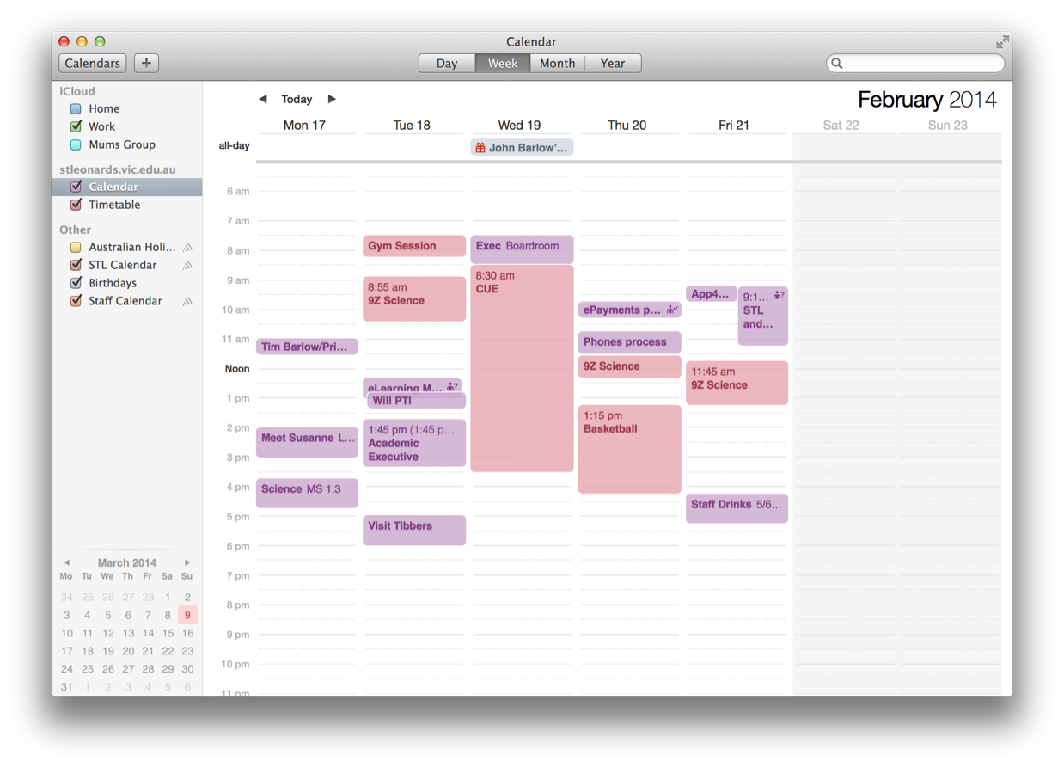
Calendars
Notes:
With the busy lives we all lead, a vital skill to help our young people develop is basic calendar maintenance. Organising the precious time they have to achieve the things they want to. Put in academic, cocurricular, sport, part time work, and study time. Even set alarms to start and end some events.

Slide 16
Subscribable Calendars
Action:
Go to the following sites and ‘subscribe’ to the year level
categories or recurring cocurricular events on your
personal device calendars.
http://learn.stleonards.vic.edu.au/calendar/
http://learn.stleonards.vic.edu.au/cocurriculumcalendar/
Notes:
STL calendars have now been launched which we hope will make everyone's life a bit simpler.

