Slide 1
ONLINE HEALTH & WELLBEING
MS PDP

Slide 2
The techno sapien: HEALTHY OR UNHEALTHY?
Do you think that people aged 12-16 have a healthy or unhealthy use of technology?
Do you think that people aged 12-16 have a healthy or unhealthy use of technology?

Slide 3
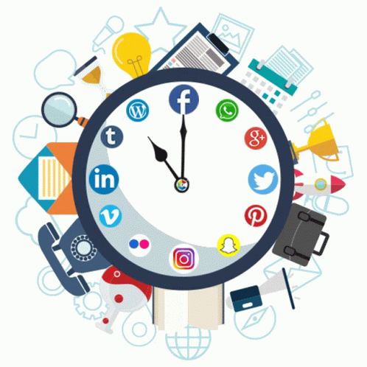
The techno sapien: HEALTHY OR UNHEALTHY?
How much time do you think is acceptable to spend online?
Are there ways to be online that are good for your health?
Are there ways to be online that are not so good for your health?
Do you think that people aged 12-16 have a healthy or unhealthy use of technology?

Slide 4
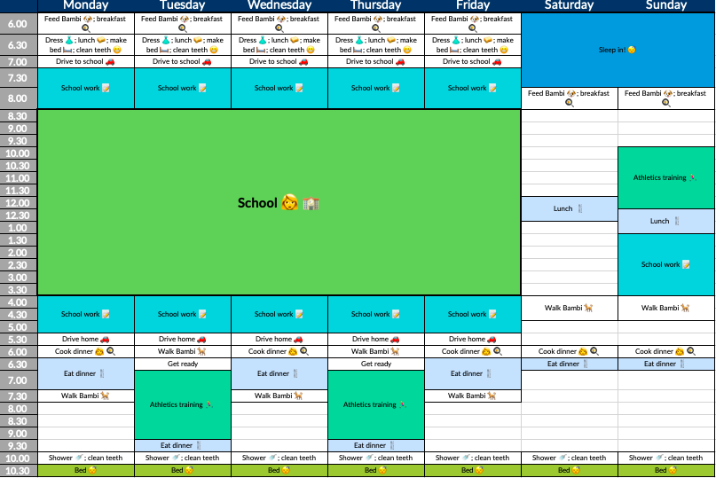
The techno sapien: HEALTHY OR UNHEALTHY?
Consider these aspects of your life:
Time
Communication skills
Sleep length/quality
Physical health
Mental health
Do you think that people aged 12-16 have a healthy or unhealthy use of technology?

Slide 5
The techno sapien PIE
Make a pie chart of your week:
Time spent on screens - check your screen time!
School - 7hrs x 5 + homework time
Family time - conversations/meals with family members
Sleep - check your fitness tracker or estimate
Physical health - exercise hours before/after school
Mental health - mindfulness, drawing off your device, cooking, playing with your pet
Do you think that people aged 12-16 have a healthy or unhealthy use of technology?

Slide 6
The techno sapien PIE
Screens
School
Family time
Sleep
Physical health
Mental health
How does yours compare?
Do you think that people aged 12-16 have a healthy or unhealthy use of technology?

Slide 7
The techno sapien: HEALTHY OR UNHEALTHY?
Positive benefits of tech for your physical health?
Negative consequences of tech for your physical health?

Slide 8
Just like food, a balanced ‘digital diet’ of screen time is key to health and happiness

Slide 9
SCREEN / LIFE BALANCE
You need to find A balance – the online world can be great, but it can also be pretty stressful.
You should be having more conversations IRL than URL (in real life vs online) – it’s a skill, it needs to be practised.
Especially if your homework needs to be done on your iPad/computer, your breaks should be tech free – ie. off your screens.
The real world is awesome 🙂 Did you know going for a walk after dinner promotes healthy discussion, reflection and gratitude, promotes digestion, helps ease stress and looking at the moon can even cure jet lag?!?!?!

Slide 10
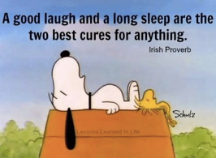
SLEEPY TIME
Teenagers need 8-10 hours of sleep each night!
Why?
maintain a healthy body
helps you fight disease
boosts energy levels, learning and concentration
helps move things from short-term to long-term memory
A lack of sleep can make it harder for you to behave well, regulate your emotions, get along with others, pay attention, and do well at school.

Slide 11
SLEEPY TIME
How?
Sleep routines – let the body know it’s time for sleeping about 40min before you actually go to bed
Tech-free bedrooms – put down the devices!
Food - warm milk, bananas, nuts all help at bedtime; avoid caffeine; healthy breakfast to start your body clock in the morning
Soft lights - reduce lights for 30-40min before bed otherwise stops release of melatonin (the sleep chemical)
Eye masks - prevents clock watching, broken sleep
Reduce worries - Talk through any problems with family before heading to bed so that they don’t worry us

Slide 12
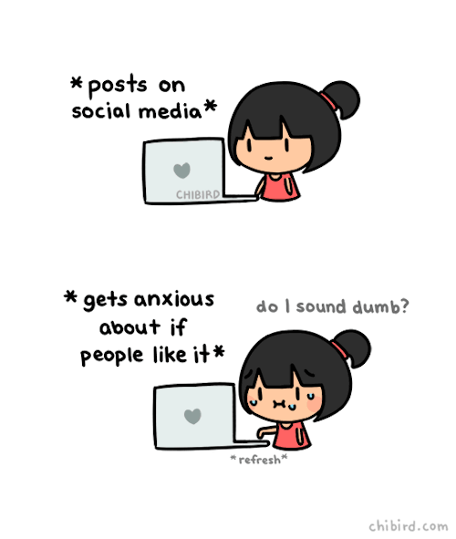
(PERFECT) POSTS
Many teens (and adults) feel a pressure to make sure that all their posts are amazing and watch the likes as if it is a window into their soul.
So, one way to improve online health is to take the pressure off your posts. Posting can be a positive experience if your posts are real and honest.

Slide 13
(PERFECT) POSTS
Remember:
Check yourself - Why are you posting it? Is it for you or someone else? Don’t post what looks cool; post what you actually like.
You can’t please everyone - Strive for quality posts over the quantity of your posts. Quality is not determined by the number of likes that you get; but by how authentic you allow your posts to be.
Post your passions and your talents - when you truly care about what you are saying, the pressure to make your post perfect falls away. Build your brand!

Slide 14
T.H.I.N.K.ING
Another way to ensure that your posts don’t negatively affect your mental health or the mental health of others is to T.H.I.N.K. before you post.

Slide 15
T.H.I.N.K.ING

Slide 16
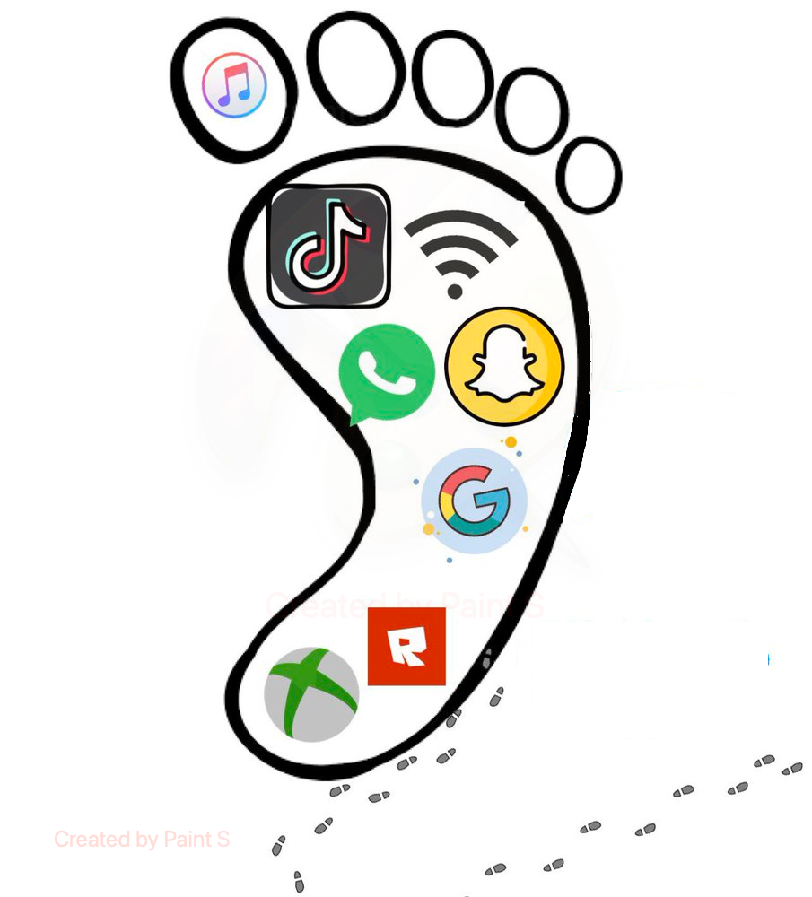
T.H.I.N.K.ING
And T.H.I.N.K. about whether you want that message to still be around in the future….

Slide 17
