Slide 1
Student Skills Workshop for Year 10 and 11 Parents
17 February 2015

Slide 2
This evening’s program The home front How to study English Preparing for tests and exams Using technology effectively for study Questions to the panel

Slide 3
The Home Front
Dr Deborah Trengove
Senior School Psychologist

Slide 4
The Home Front Getting involved Multitasking Performance issues The procrastination trap

Slide 5
Two Important Reminders Individual differences 80 / 20 Guide

Slide 6
Getting Involved
Practical | Test revision Proof reading Listening to orals Discussing texts (read them)
Planning and organisation | Model it! Minimise clashes Dates and calendars
Support routines | Early work > later Limit distractions
Focus on effort | Encourage effort Expect effort Recognise effort
Revision methods | Regular review Reorganise / rewrite notes Active learning Identify areas of confusion

Slide 7
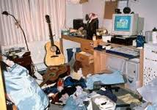
Work spaces

Slide 8
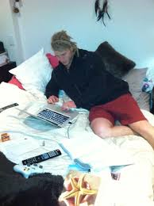

Slide 9
Multitasking

Slide 10
Multi-tasking is really task switching Average of 64 seconds to recover train of thought after checking email Complex tasks take up to 4 times longer Disorganised memory Increased fatigue and stress levels

Slide 11
The alternative to multi-tasking Do one thing at a time – separate social from study Manage sources of distraction Increase efficiency, enjoyment and satisfaction Work against attention deficit trait Reduce stress, cut down errors

Slide 12
Performance Issues - beforehand Early preparation Focus on task not outcome Results worth Nerves - breathing

Slide 13
Performance Issues - Responding to results Perspective Growth approach Pay attention to what went well Review preparation

Slide 14
The procrastination trap

Slide 15
Procrastination is ……….. Not new Chronic for 20%, regular for 50-80% Related to self-regulation A gap between intention and action

Slide 16
Different types of procrastinating They all end in …….later
It’s too hard
It’s too boring
I don’t know where to start
I can’t finish it all at once
I work better under pressure
It won’t be very good

Slide 17
Different strategies
Start early | Break tasks down
5 minute technique | Worst first
Visual reminders | Easy first
Formal start time | “Fake” deadlines
Self-rewards | Accept discomfort
Daily goals | Increased structure
Remove distractions
 | Change environment
Plan each session

Slide 18
Study Skills for Parents
Studying English in the Senior School
Notes:
This is a screencast of a presentation on Study Skills for Parents on Wednesday 13th March 2013.

Slide 19
Mr Jonathan Hunter
Head of Newman House
IB and VCE English teacher
Email: Jonathan.Hunter@stleonards.vic.edu.au
Notes:
My name is Susanne Haake. I am a VCE English teacher and Director of eLearning at St Leonard's College. I have worked for 10 years as a VCE English teacher and in a previous school spent 4 years as a VCE Coordinator. We hope that this will provide parents some further information and strategies so that they are able to assist their Upper School student.

Slide 20
Texts Studied in SS English
Notes:
The Upper School English program looks at a range of texts across different text types. This will include fiction and non fiction print texts, film, media texts, spoken texts and issues presented in the media in a variety of forms. There is an increase in the number of texts students are expected to read and their complexity. Students will often be exposed to texts in translation. While many of the texts are familiar to parents and may even have been texts that you studied yourself, there is an increasing move to balance text choices between traditional Literature and also provide students exposure to new authors and authors who choose to present their ideas in a variety of textual forms.

Slide 21
Year 10 and VCE/ IB Program
Year 10 Program prepares students for both IB and VCE.
Academically rigorous.
Challenging themes, values and ideas.
Exposure to a range of text types, contexts and themes.
Notes:
The Upper School English program is about skill acquisition and development. Students are likely to experience a change in expectations from Year 9 to Year 10 and similarly Year 11 to Year 12 – irrespective of whether they are VCE or IB students. The English team works very hard to ensure that our students are working from year 10 to gain the skills necessary for them to successfully complete their VCE or IB program to the best of their ability. The texts chosen in these programs will necessarily be challenging and are designed to explore values and the human condition.

Slide 22
Tools of the Trade
Notes:
Preparation is the first key to success in studying English. For every year level we ask that students acquire the texts as soon as possible at the end of the previous year to begin preparation. They will need access to a print dictionary. A thesaurus will be useful for homework and study but must be a separate volume as they are not permitted in assessments. With the development of the Content Management System via STL Link, a device of some kind will allow students to access the learning material and other resources available on STL Link. We will look at STL Link in a little more detail later. While some work may be typed or presented in other electronic forms, all assessments are handwritten and students should make sure they have access to lined paper, pens, highlighters and post-it notes.

Slide 23
Expectations for Year 12
Texts will be read/listened to at least once before the start of the year and 4-5 times by the time of assessment.
Act on feedback.
VCE - a 3-4 page essay building to a 4-5 page essay for the exam (3 papers).
IB – a 3-4 page essay building to an 6-7 page essay in the exam (2 papers).
At least one written task/essay per week.
3-4 hours of home learning per week.
Parents read the texts too!
Notes:
It is useful to understand that expectations for your child's final year of secondary schooling and then to work back from that. The completion of the VCE or IB program can be likened to a marathon (and at times a grueling one). It is unrealistic to expect a student to all of a sudden at the start of year 12 have the discipline, focus and skills required to successfully complete the program. For this reason we work hard to model the expectations at year 11 and year 10. There is clear expectation that students in year 10 will be reading the text at least twice before completing an assessment task on it. There will still be at least one piece of written work per week for year 10 students, but this might be shorter chapter questions or paragraphs and we would expect students are completing around 2 hours of homework per week for English.
***
Back to year 12

Slide 24
Reading for Meaning
Active reading - where to read and when.
Synthesising information and making connections across a text.
Read - Think - Check - Discuss - Reread.
Highlighting and note taking (Annotating).
Brainstorming, mindmaps, CSI’s
Conversation is the bridge of understanding!
Notes:
One of the skills students need to develop in Upper School is the the ability to read to meaning. Year 11 and 12 VCE students this year were given a text quiz at the start of the year and while almost all had read the texts over the summer, a much smaller percentage had retained sufficient information and detail to successfully complete the quiz. A number of students have said to me that this has highlighted for them that reading a text to know what it is about and reading it to understand and remember the detail are two different things.
We encourage all students to first read their English texts to understand the plot, characters and general themes. This is great holiday reading and casual reading before bed, etc. After an initial reading, students should be able to articulate the plot, main characters and 3-4 main themes. We certainly expect that students will start the read with the texts read at least once and we encourage Year 11 and Year 12 students to begin their active reading of the text before the start of the year.
Active reading requires reading a chapter or selection, thinking about the application of this information to the broader themes, checking chapter notes and other resources for details and perspectives on the text, discussing ideas and interpretations with others and then rereading. Making connections and deep level of understanding.
Active reading also involves making notes in margins, highlighting text, adding post it notes, etc. As teachers we describe texts as the tools of the trade and while we wouldn't expect a carpenter to keep his hammer in pristine condition, we don't expect an active and engages student to have their text in pristine condition. A well read and well used text should be almost falling apart by the end of the year.

Slide 25
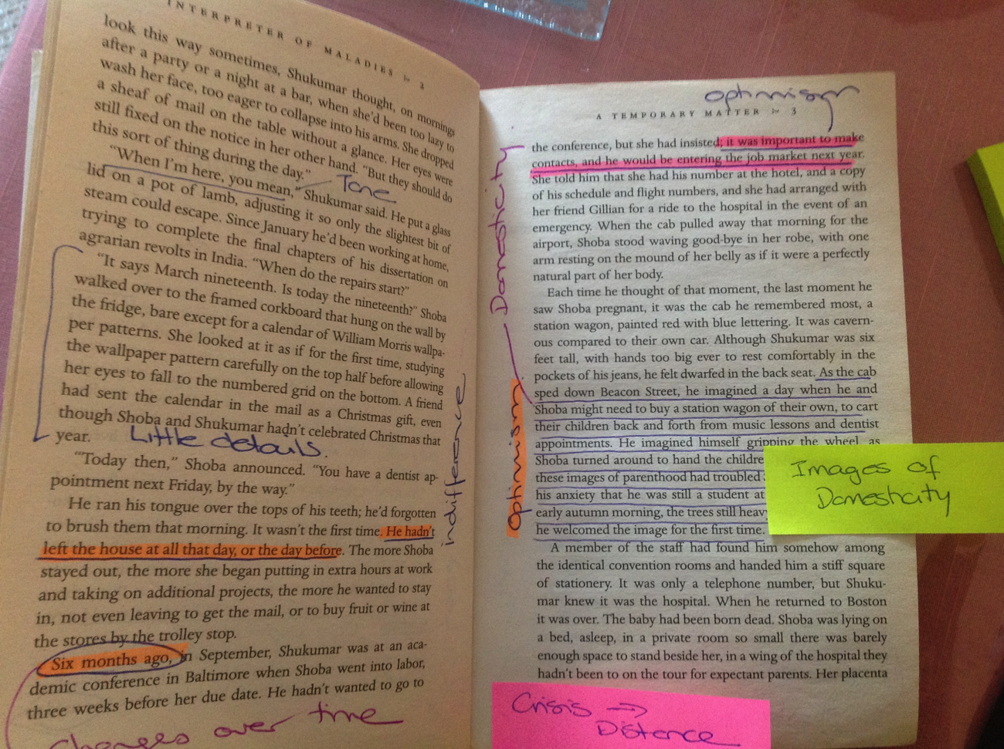
Notes:
Here is one example of an annotated English text. Most pages of an actively read English text should look like this. There should be relevant sections highlighted, notes in margins, post it notes adding in extra information. Some students go so far as to colour code their annotations, but certainly a well annotated text will make revision much easier.

Slide 26
Note Taking
Understanding the Purpose and Process.
Various methods - commonality is usefulness, clarity and stand alone nature of notes.
Many students find the Cornell method the most useful.
Not 'One Size Fits All' but students need to quickly find a method that works for them.
Notes:
It is important that students understand the purpose of note taking as well as the purpose and this is certainly something that we review in class and also as part of the Upper School Personal Development Program.
Students may take notes from class lectures or indeed guest speakers, but mostly they will be taking notes based on their reading and reviewing texts and other material.
Note taking is not a 'one size fits all' process and students will need to find a method that works for them. That said, there are commonalities across all methods of note taking. It needs to be understood by the person who is going to refer back to it; it needs to be a resource in itself for revision; it needs to be clearly organised.
Many students find the Cornel Method of note taking useful.

Slide 27
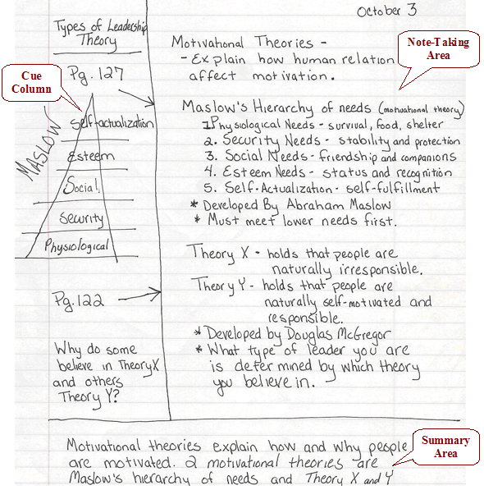
Notes:
The Cornell Method of note taking involves taking notes to the right of a centre margin and then reviewing those notes and distilling the salient points into key words and ideas on the left side of the centre margin.

Slide 28
Differences between Homework and Study
What is Homework?
Weekly tasks that are handed in for comment/ feedback.
Summaries, chapter questions, essays, presentations.
What is Study?
Preparation for assessment.
Reviewing notes, rewriting notes, memorising quotes, revising characters, themes, plans.
Practice exams.
Notes:
We often hear students claim that they cant study for English. It is important that students understand the difference between homework and study and in supporting your child and assisting them in managing their time it is also important that parents are able to assist students to make this distinction.
Homework will be weekly tasks that are assigned by the teacher. Some of these tasks will be collected and form part of the formative assessment for English and other tasks are designed to extend the work and discussion that has taken place in class.
Study tasks in English will centre around cementing understanding and preparing for assessment. This will involve reviewing notes, listening to podcasts and screen casts discussing various aspects of the course content, making summaries and importantly, memorising quotes from texts.

Slide 29
Revision
Revision for English should be embedded into a student's weekly program.
Reviewing Notes, Text/ Story/ Character Summaries, Planning Essay topics.
Revision needs to be catered to the students' strength and learning style.
Notes:
Revision of English needs to be a planned part of the weekly study/ homework schedule. Many students leave their 'revision' for English to just before an assessment task without understanding that unlike subjects that involve rote learning, English requires times for ideas to take shape, for connections to be made and for perspectives to mature. This won't happen in the 48 hours before an assessment task.

Slide 30
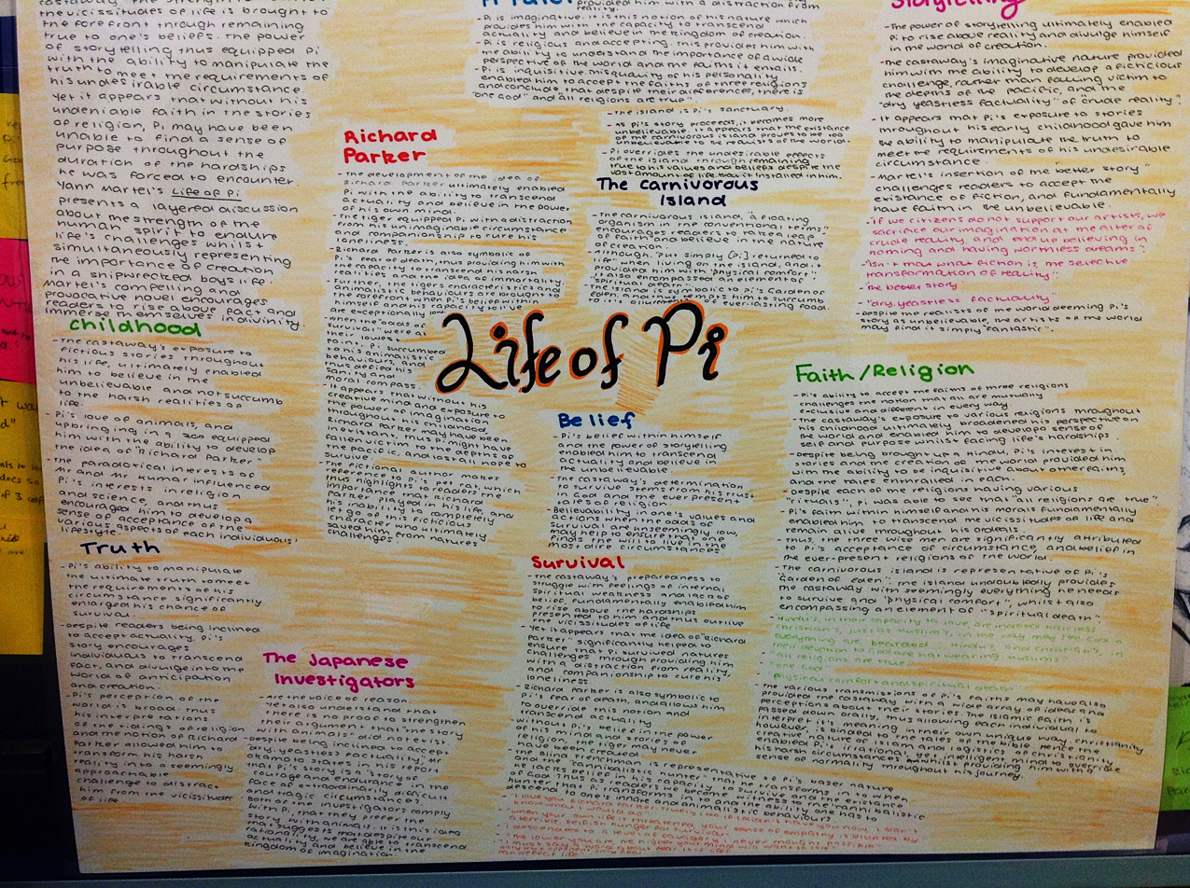
Notes:
This is one example of a revision chart prepared by a Year 12 student in 2012.

Slide 31
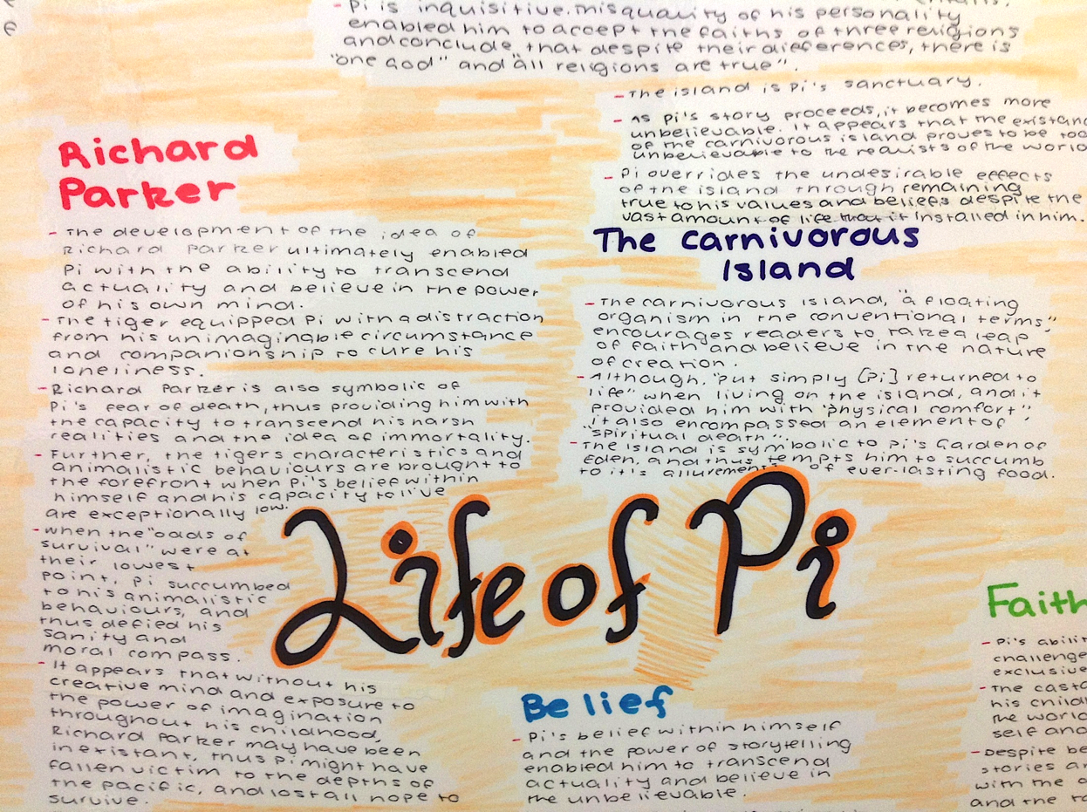
Notes:
This provides a little more detail and shows how the student was able to take their notes translate this into a fairly detailed wall chart.

Slide 32
Strategies to Help Students
Range of strategies at school.
Reinforce positive messages around English at home.
Engage in active discussion about texts, media units, oral presentations.
Study Groups.
CRC open after school and on Sundays.
Notes:
There is no doubt that English provides a challenge for some students and as teachers we understand that it will not be a strength of every student despite the fact that it is a compulsory subject for all students. To that end it is important that there are a range of strategies at school and at home to assist students. English teaching teams meet regularly and identify students who would benefit from additional support. This if offered through the Learning Support department and may include support in class or additional tutorial sessions after school or for Year 11 and 12 students, in their study blocks. Add extension.
For students who struggle, the message they play on their internal radio station is very important. If they tell themselves they can’t do English, it will make it even harder. It might be for some parents that English was not the easiest subject they did at school. There is a real danger in articulating that at home. I had a student in 2012 who struggled with English and in meetings with the parents both repeated in front of their child how hard English was for them and how they “were never any good at it”. This reinforced in the child’s mind that it was a virtually impossible task. As with anything, we need to be modelling best practice for students. We encourage parents or older siblings at home to read the texts being studied by your child. The most valuable support you can offer your child in terms of English is the ability to discuss texts and indeed read over their work with a knowledge of the material they are discussing. Also discuss ideas in the media and encourage their critical thinking.
Some students benefit from working with their peers in informal study groups and I know of a number of Year 11 students who met together over the summer for 'reading' pool parties to make sure they were prepared for the text quiz in the first week of term. Important for SAC and Exam revision.

Slide 33
Resources
www.vcaa.vic.edu.au
http://www.ibo.org/
https://stllink.stleonards.vic.edu.au/Learning/Pages/default.aspx
Notes:
The VCAA website will offer access to past VCE exams and examiners reports for all VCE subjects. IB teachers will provide and upload to STL Link a range of resources including sample papers and examiner's reports.
Before we conclude, let’s take a quick look at the material available on STL Link. At the end of 2012 all families receied an email with login details to access STL Link. If you have misplaces those details or require assistance in logging in, please contact the College and ask to speak to the IT Help Desk. They will be able to reset your log in details and email you instructions for accessing the site. STL Link was created in 2012 as a learning portal and Content Management System for St Leonard's COllege. With all students in years 5-9 using iPads in 2013 and upper school students using their own device, a platform that enabled students to access learning material has been an important and necessary addition to our ability to deliver excellent learning opportunities for your students.
Let's take a quick look at STL Link now...

Slide 34
Notes:
STL Link can be accessed from the St Leonard's College homepage. From this page you will be asked to enter a username and password. Students are already accessing STL Link on a daily basis and certainly in English all of the course content and resources are available on this site.

Slide 35
Notes:
Once you log in you will be taken to this landing page. This will give you access to College Information and the Learning Tab

Slide 36
Notes:
When you click on learning, you will access the site which has content across all year levels. As an example, let's go to the VCE page...

Slide 37
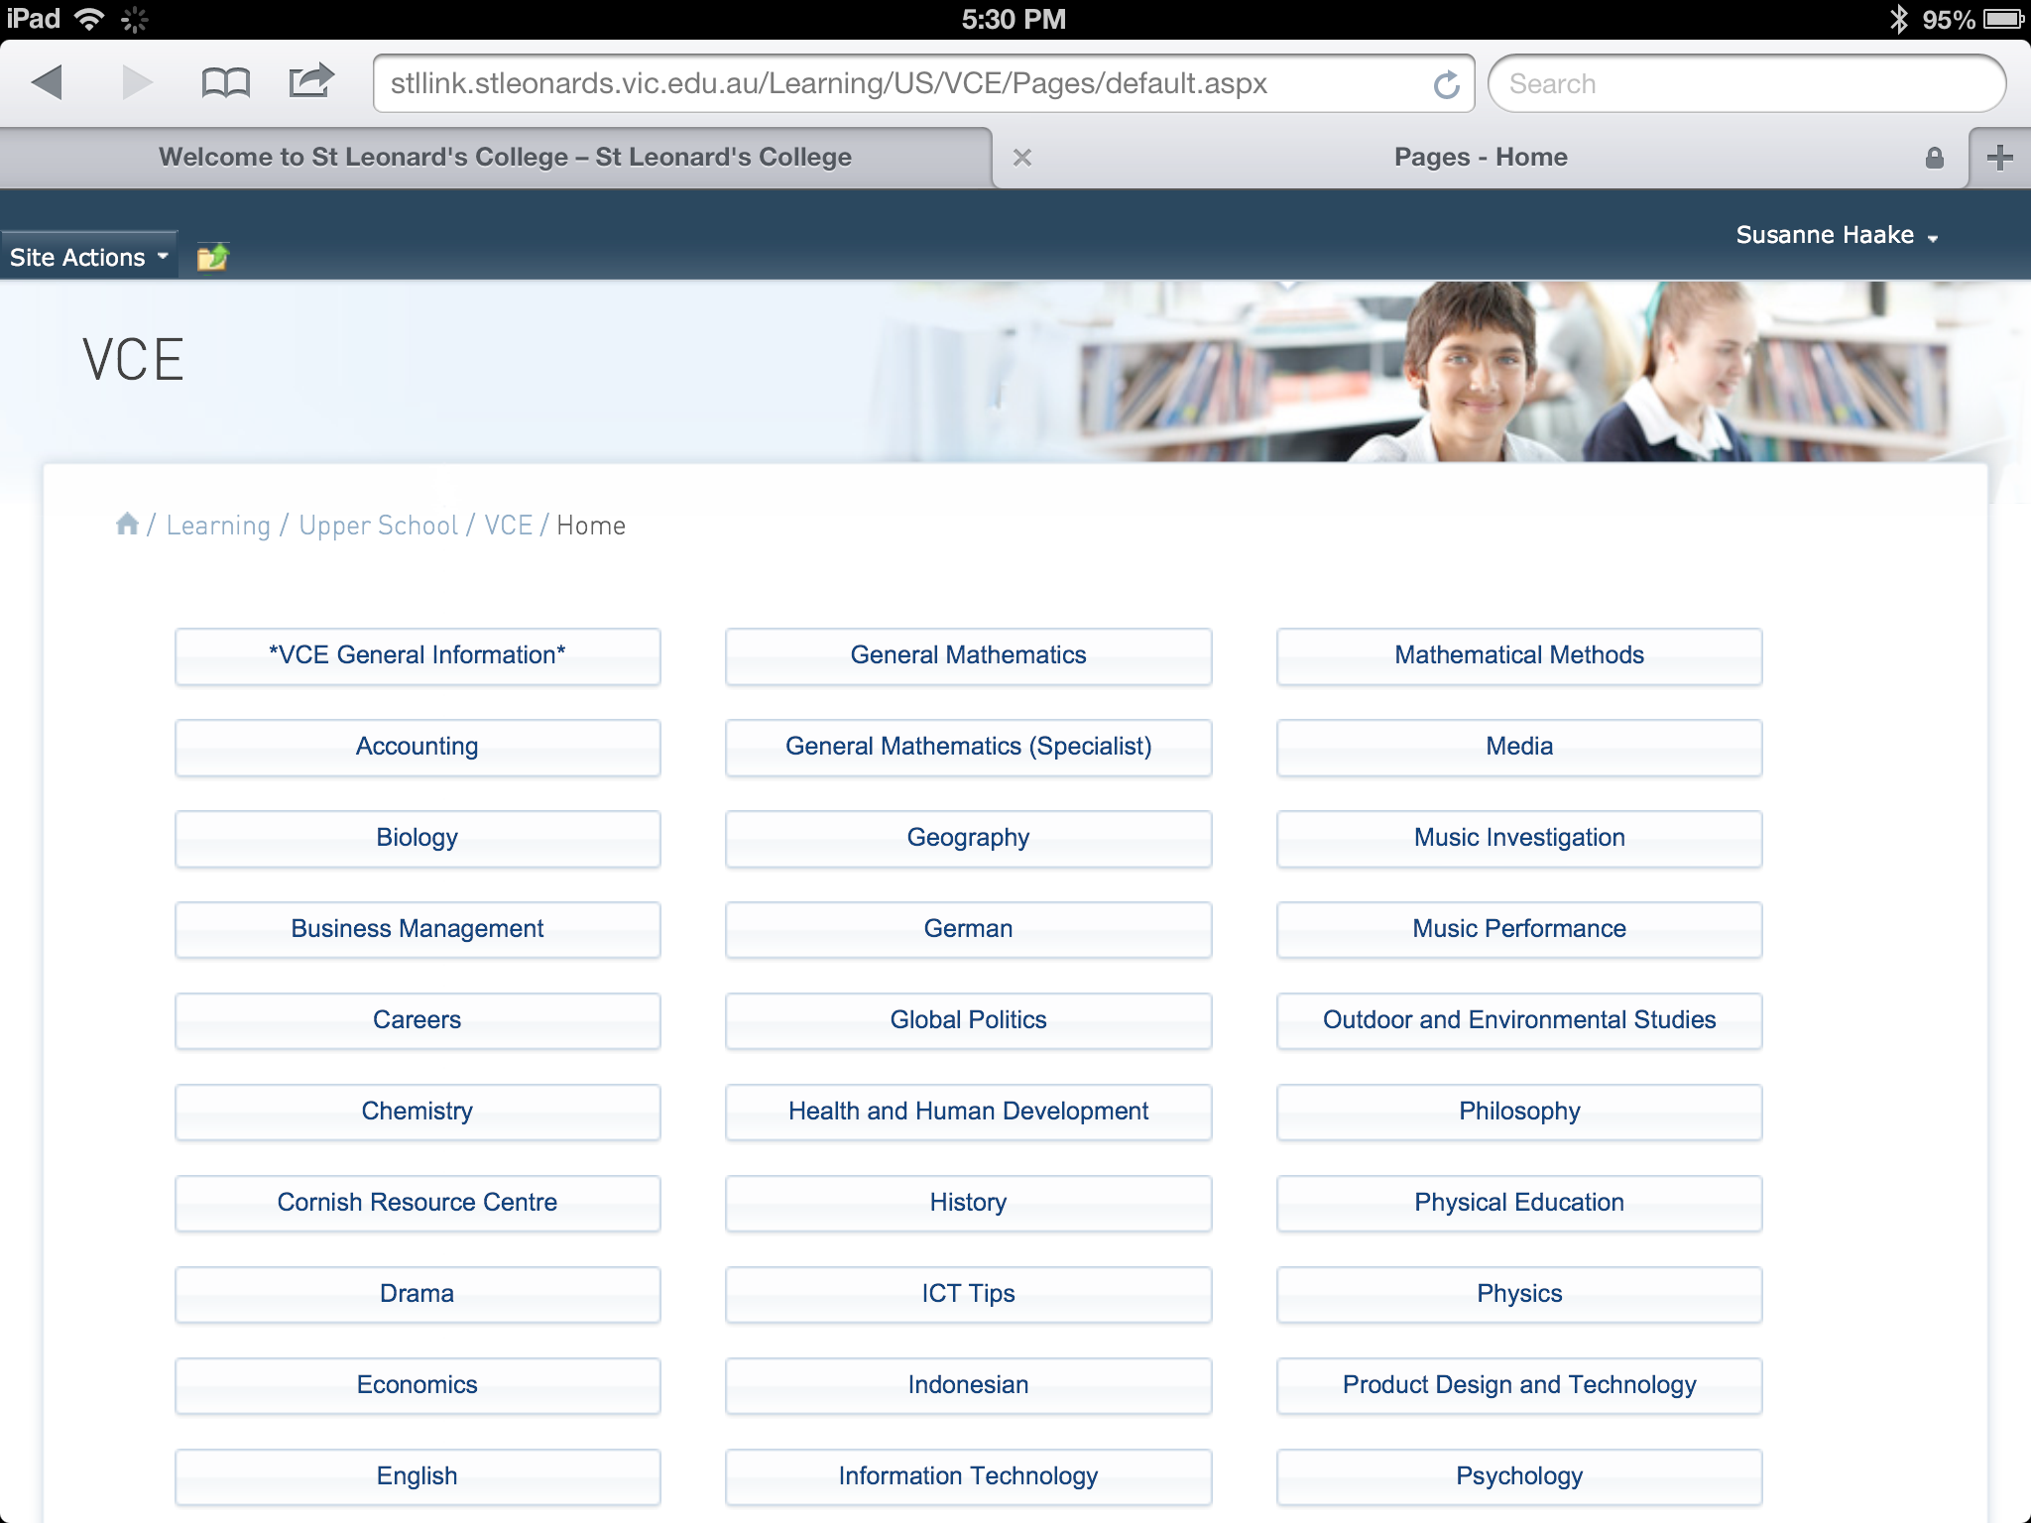
Notes:
And then from the VCE page go to the English page.

Slide 38
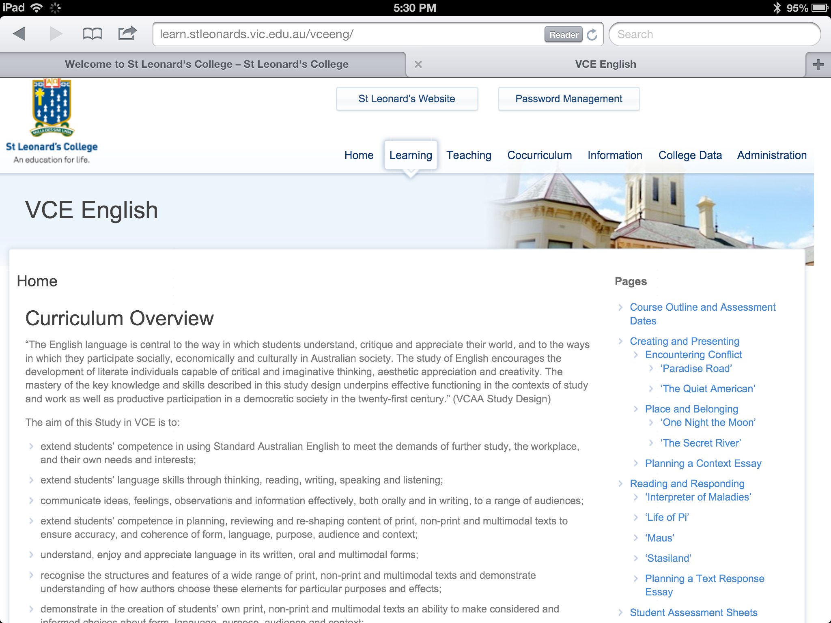
Notes:
On the homepage of the VCE English site you have an overview of the VCE program. To the right you have a course outlines and pages for each area of the course for both year 11 and year 12.

Slide 39
Notes:
Further down on the VCE English page you will see upcoming assessment dates.

Slide 40
Notes:
This screencast and other relevant resources are on the Parent Learning site and we encourage you to check this page regularly for information that will assist you in supporting your child's education.

Slide 41
Studying and examination presentation
Julianne Dennett
Deputy Head of Senior School

Slide 42
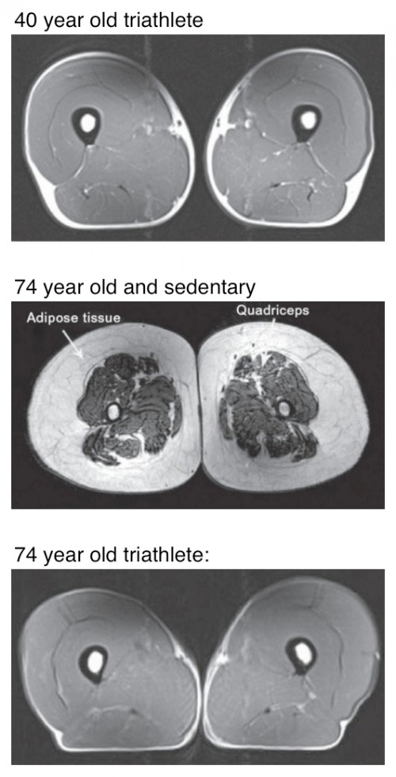
The use it or lose it principle of learning
Notes:
40yr old, 74yr old.
We can grow and maintain our muscles. This is visually obvious to all of us. When we train our muscles with particular tasks - the cells of our body change and develop to improve our ability to complete those tasks - but we have to make our muscle cells work hard.

Slide 43
Attention: mindfulness and deep processing
Wasting time – We read & re-read because the mind wanders off without realising
Effects on the Brain – un-mindfulness or inattention makes the brain unfit; it does not develop connections effectively and ages faster.
Not understanding – Are we attending to what is being explained and listening or is our attention misdirected into an internal dialogue ‘I can’t do this.’
If we practise distraction we get good at it
A hallmark of successful & happy people is that we can get on with necessary things even when they would rather not – deal with procrastination.
Poor Memory: notice and recall (Hassed and Chambers: Mindful Learning) Activity 1. on attending below
https://activememory.com/playzone/freeplay/games
Activity 2. Acronym

Slide 44
Steps to better study
Prepare - read ahead and take notes; refer to the study design or syllabus
Use record book, planner and work back from the examination date
Pay attention in class; learn as you do your homework and do brain training to increase attention
Check and plan learning: Use internet revision resources: PowerPoints, apps
Know and understand mark schemes
Know Command (key) terms, pull questions apart, plan, checklists
Do practice questions as you learn
Do practice exams as you re-learn – at first not to time and then to time.
Eat, sleep, exercise and drink well – you don’t have enough time when you don’t plan your time.

Slide 45
Prepare for lessons and use study designs and syllabus
VCE Unit 3/4
The course, past exams, examiners reports, exam timetables are available to everyone.
http://www.vcaa.vic.edu.au/Pages/index.aspx
General Achievement Test (GAT) Wednesday 11 June, 10.00 am – 1.15 pm
October Performance and Languages Oral Examinations Monday 6 October – Sunday 2 November
October/November Written Examinations Wednesday 29 October – Friday 21 November
The 2014 VCE end-of-year written examination
timetable will be published in May.
VCE Unit ½ are available on Stlink
http://learn.stleonards.vic.edu.au/vceinfo/
IB Syllabus
C:\Users\jdennett\Documents\2014 IB\psych ib syllabus.pdf

Slide 46
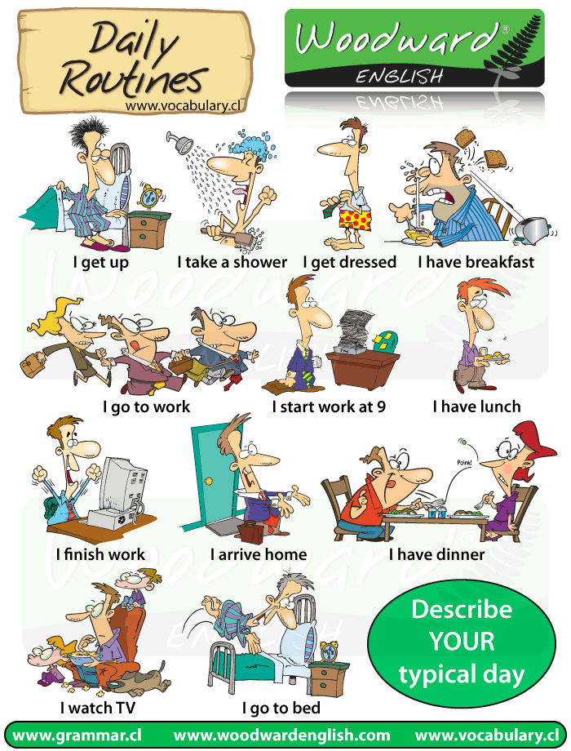
Use diaries, calendars and planners and work back from your exam.
All exam dates should be in and weeks marked off
Book lectures
Special events should be marked and study around them.

Slide 47
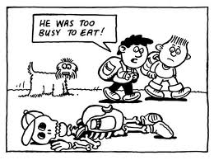
Pay attention; learn as you go and brain train Study is not separate from homework/learning and class learning . Aim to gain more from learning by concentrating/deep practising, being mindful during lessons, during homework/learning and during study. Students should study as they go; not just do tasks for the sake of doing them – each and every time a task is set the student should ask: “What is this task achieving? What am I to learn? What has this got to do with my previous learning and the study design/syllabus? Home learn! It is the student job to engage. “I am too busy doing homework to study.”
Notes:
In the study, students switched back and forth from week to week between two different styles of homework. One style, which followed the standard practice that Baraniuk has used for years, consisted of one homework assignment per week, which was graded and returned the following week. The second style, which was called the "intervention," incorporated three principles from cognitive science that have been shown to promote learning and increase long-term retention.
The principles were implemented in the following way:
Repeated retrieval practice -- In addition to receiving the standard homework assignment, students were given follow-up problems on the same topic in two additional assignments that counted only toward their course participation grade.
Spacing -- Rather than giving all the problem sets for a week's lectures in one assignment, the researchers spaced the problems over three weeks of assignments.
Feedback -- Rather than waiting one week to learn how they did, students received immediate feedback on intervention homework, and they were required to view the feedback to get credit for the assignment.
"Giving students multiple opportunities to practice retrieving and applying their knowledge on new problems is a very powerful way to promote learning, especially when this practice is spaced out over time," said study co-author Elizabeth Marsh, associate professor of psychology and neuroscience at Duke. "Feedback also is critical to learning, and previous studies have shown that students will often skip looking at feedback."

Slide 48
Class learning and home learning are all part of study
Students should : keep good records of the home learning set, done and its purpose.
See teacher if they can’t do it. Send a request for help straight to the teacher’s calendar
Ask the teacher if they don’t understand what you should be learning.
Check all learning, take notes against the study design or Syllabus
Be mindful of command terms
Be a partner in their learning with their teacher.
Book and attend lectures
Attend extra help sessions.
Use flashcard apps
Use online quizzes
Search for Youtube clips, PowerPoints to help with learning
Students need to be sure of what they are trying to learn and be progressive in learning over time.

Slide 49
Determine content
Determine shortfalls in understanding – tests, SACs, study design, syllabus, notes, lectures
Determine make up of exam and marks.
Revise home learning calendar to increase specific study
Expand notes, underlining key terms and then,
Reduce notes
Make visual links, make links, answer scenarios with content.
Do practice questions and fix and deep process answers into memory.
Do practice papers. Correct them, record corrections
Do practice papers to time.
Involve students in online discussion groups.

Slide 50
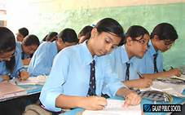
As the exam nears……….
Find out how exam will be presented and how many marks go to each section
Gather Resources
Ideally, 4-6 weeks before exams, start focused revision, at least 3-4 weeks
Put exam dates on planner
Count the weeks back to now
Create extra study time in your weekly planner that starts small, about ¾ hour pure study a night in week 1 to 3 hours study per night in the last 3 weeks before exam.
Use SACS and in-class work – review these and use as a guide for focus

Slide 51
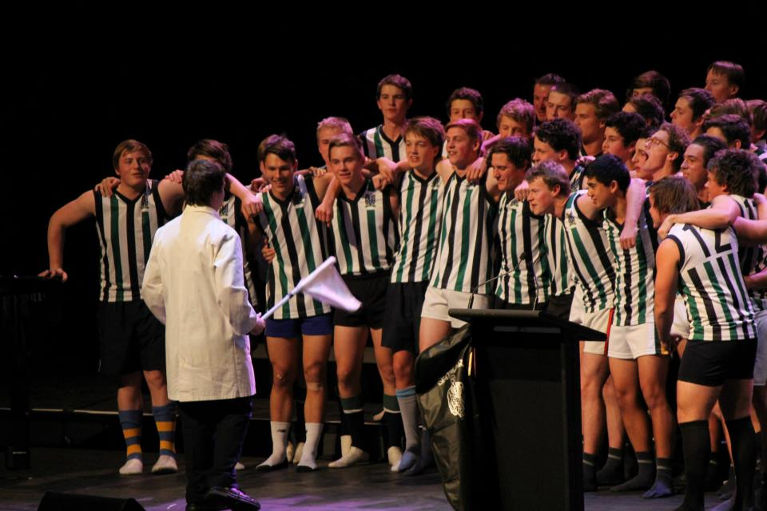
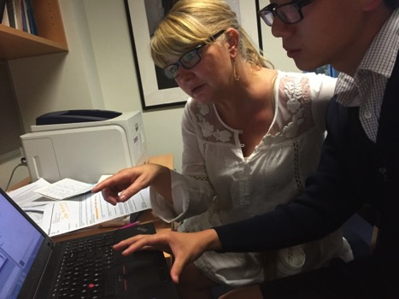
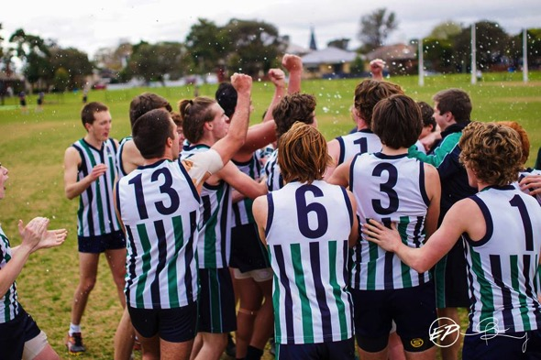

Slide 52
Using Technology effectively for study
Tim Barlow
Director of Technology Innovation
Notes:
Welcome.

Slide 53
Organisation
Notes:
There are a series of common tools and activities that improve organisation and task completion: Things like to do lists, post it notes, calendars or diaries.

Slide 54
Increased efficiency
Notes:
And as with all things, computers simply increase the efficiency, speed and scale with which things can be done. This includes organisation and effective study.

Slide 55
Notes:
I think it is important to point out that while we can increase efficiency in organisation, work flows and many other auto-matable tasks. We CAN NOT change the fact that learning is the new connections between brain cells and this ABSOLUTELY REQUIRES time on the learning task by the learning brain.

Slide 56
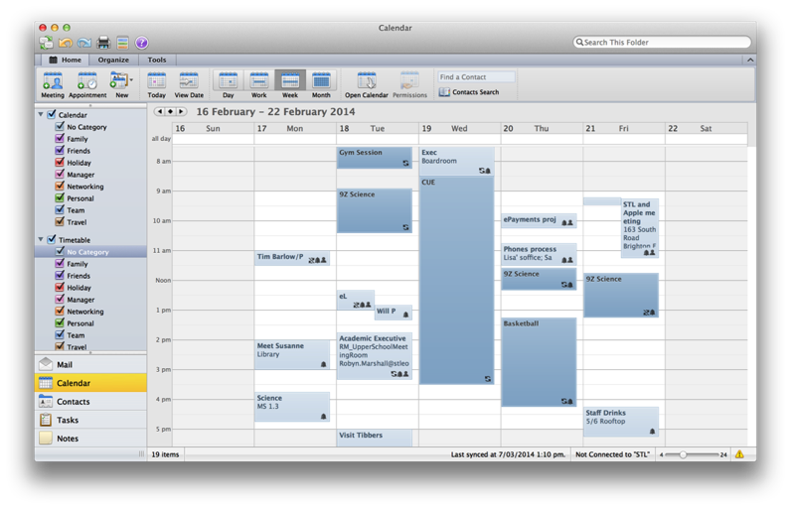
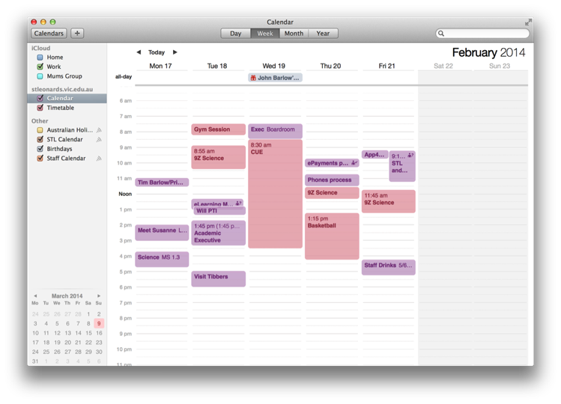
Calendars
http://learn.stleonards.vic.edu.au/calendar/
Notes:
So the things technology can help with … With the busy lives we all lead, a vital skill to help our young people develop is basic calendar maintenance. Organising the precious time they have to achieve the things they want to. Put in academic, cocurricular, sport, part time work, and study time. Even set alarms to start and end some events.
And subscribe to the relevant STL calendar feed.

Slide 57
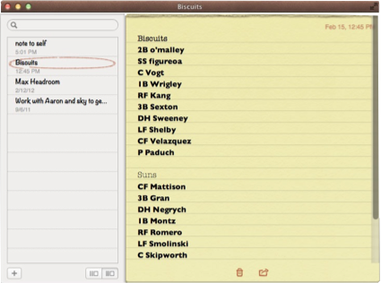
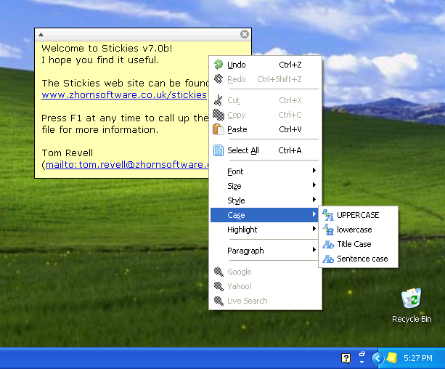
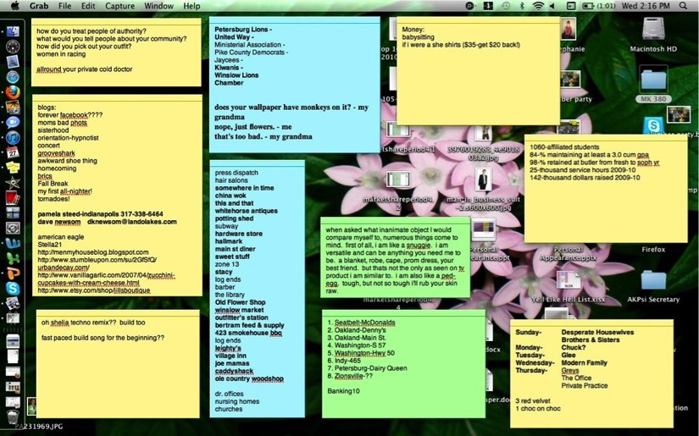
Notes
Notes:
Make a to do list for your day, week, month or just a constantly updated and prioritised list.
Many notes apps now sync across devices too so you can update on your phone and find it on your tablet or laptop.

Slide 58
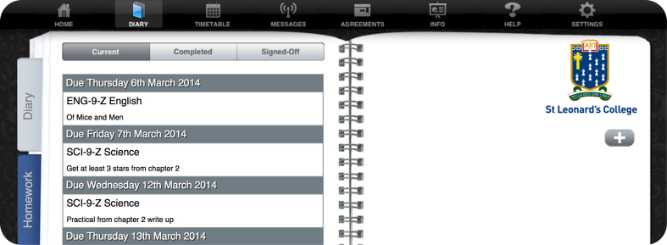
App4
http://stleonards.app4.ws/
Notes:
All students do have access to a school provided web based diary, to do list, timetable system in App4.
All parents can see their students diary too.

Slide 59
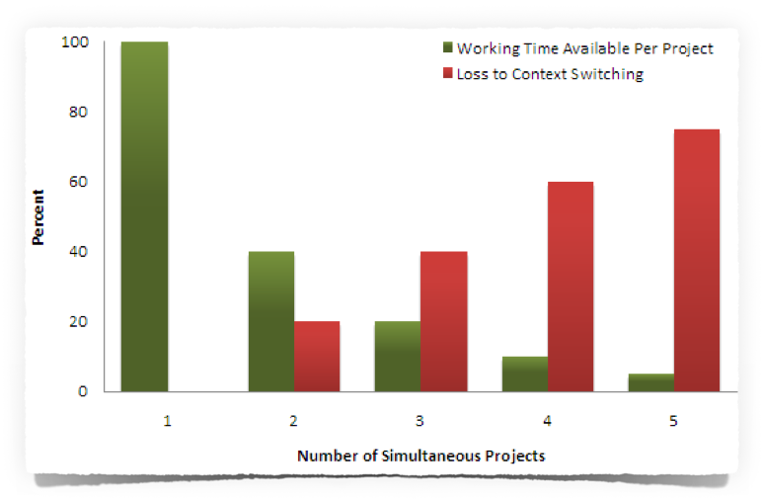
The Multitasking Myth
Notes:
Demo - ABC…, 123…, A1B2C3…
The human brain simply cannot multitask with even relatively simple cognitive things!
We can do cognitive things shortly after the other and this gives the illusion of multitasking. Unfortunately, each ‘task switch’ costs time and lots of task switching adds up to lots of time lost.

Slide 60
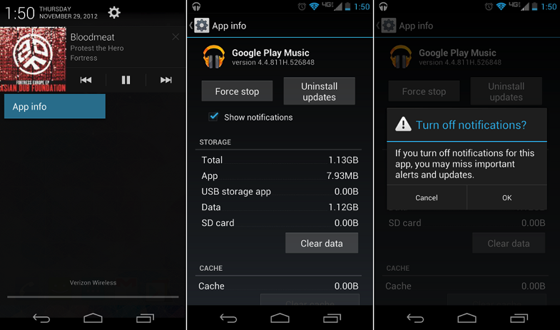
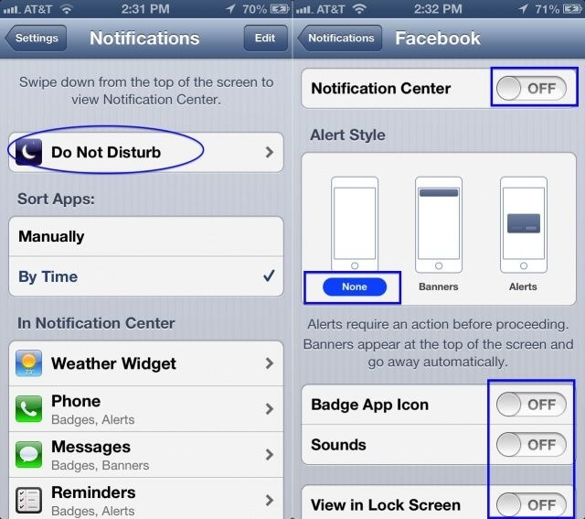
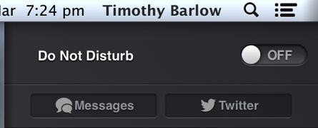
Turning notifications off
Notes:
This is one of the golden tips especially when we consider the multitasking myth.
Turn off notifications on the phone, tablet and laptop when studying.

Slide 61
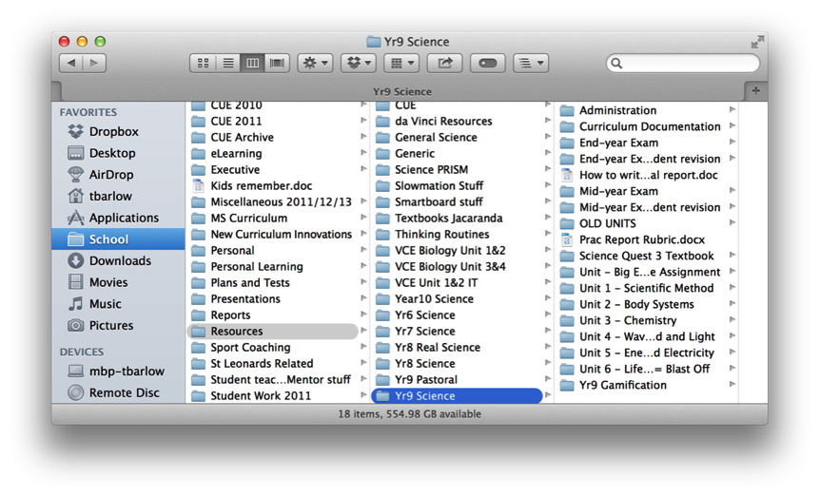
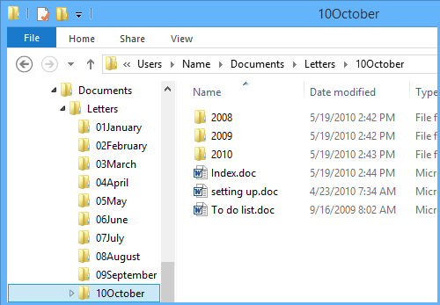
Files and Folders
Consistent naming.
Start with the year and month.
A folder for each subject with sub-folders.
Notes:
Name files appropriately. Store files in appropriate folders.
This kind of thing may sound obvious - but you’d be surprised how many students don’t do this.

Slide 62
Google Drive, iCloud,
OneDrive or Dropbox
Notes:
Online document storage is now a wealth of choice. And the free online productivity suites of software available from Apple, Google and Microsoft are very good.

Slide 63
Podcasts and YouTube
Notes:
A fantastic use of time when it comes to study is the use of educational media. If your child finds themselves regularly in a situation where sitting down at a desk is impossible, they can still get great benefit from an audio podcast or video content. Staff may be able to direct students to content but also encourage students to find material that clicks with them. There is so very much stuff out there these days.

Slide 64
Flashcards
Notes:
Flashcards are also a great study tool, and they to are increasingly cross platform and students can store their flashcards in the cloud.

Slide 65
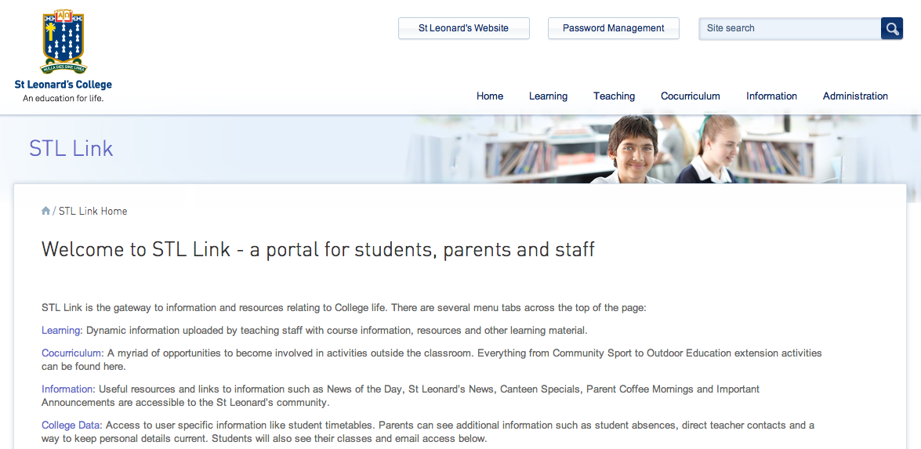
STL Link
Notes:
The teaching staff have, over the past year or so, created an absolute gold mine of educational resources like past exams. Your students are directed to this in their classes so it can be worthwhile to remind them that it can be a valuable first port of call for some study sessions.

Slide 66
Forming good habits
Notes:
All of the things I have spoken about are not difficult. But to be truly effective they must become habits - that is a behaviour that is repeated regularly and tends to occur unconsciously. To form a habit first the behaviour must be repeated consciously many, many times over.

Slide 67
I forgot
http://learn.stleonards.vic.edu.au/parents/presentations/
Notes:
I have also mentioned a lot. Fortunately you can also benefit from technology as everything I have gone over is up on the ‘Parent Learning’ set of STL Link.

Slide 68
QUESTIONS
Notes:
Feel free to get in contact if more assistance is required.

