Slide 1
Motivating Students to Achieve their Personal Best

Slide 2
Tonight’s Program What is Motivation? Student Panel Parent Panel Questions and comments
Notes:
Introduce panel

Slide 3
What is motivation? Motivation refers to factors that activate, direct, and sustain goal-directed behaviour... Motives are the "whys" of behaviour - the needs or wants that drive behaviour and explain what we do. We don't actually observe a motive; rather, we infer that one exists based on the behaviour we observe. (Novid, 2013)

Slide 4
Motivated students show: Greater effort Greater persistence Are goal directed Respond positively to challenges Enjoyment of learning 2004 National Research Council study

Slide 5
Complex and multidimensional
Relationships – parents, peers, teachers
Skills – talents, interests, successes
Personal – anxiety, moods, self-efficacy
Dynamic – can fluctuate over time, normal in teenagers and life cycle

Slide 6
A few studies
Parenting style – authoritarian v authoritative v
permissive; authoritative most effective for motivation
Authoritative style – based on communication, shared responsibility for learning & following up expectations
2. Parents v teachers influence
Parents most influence at primary, while teachers can have
more influence at secondary
3. Peers – important for belonging; positive impact for
subjects in non-stereotyped subjects, having like-minded
peers helps motivation
4. Self-efficacy – more important for girls > boys in terms of
academic resilience
Notes:
Parenting style related to strongest motivation – based on communication, sharing responsibility for learning, following up expectations; Parent involvement in primary often sets the ground work for positive motivation; a sense of belonging and feeling valued & respected is shown to increase achievement motivation; peer support is correlated to motivation for learning in areas not stereotypically associated with gender – eg for girls studying maths / science, the peers make a significant difference; teacher relationships are a stronger predictor of academic outcomes once students reach secondary school than are parents relationships; they aid engagement; girls are more vulnerable to the impact of lower self-efficacy and anxiety than boys; if girls don’t believe they are good at something, they are likely to show less academic resilience; boys are more likely to believe they will be OK in the end….sometimes delusional

Slide 7
Tale of two students Jack Jill

Slide 8
Jack
Performs well
Enjoys school
Focuses on his own goals
Plans and organises
Comfortable in tests
Persists

Slide 9
Jill
Underachieves Unhappy and bored Nervous in tests Procrastinates Gives up easily Talks of leaving

Slide 10
3 Key Elements of Motivation
Self-belief
Value of
schooling
Learning
focus
Creates success experiences
Lacking confidence
Goals related to school
What’s the point?
Mastery and personal best
Afraid of failing

Slide 11
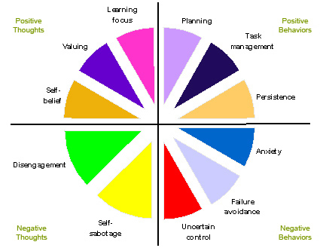
Model of Motivation Professor Andrew Martin: boosters (positive thoughts & behaviours) and sappers (negative thoughts & behaviours)
Notes:
Australian academic Andrew Martin – elements which boost motivation and those which sap it; gives a framework for strengthening and protecting motivation

Slide 12
The good news!

Slide 13
What can parents do? 5 Keys
Build Confidence
Find a Connection
Develop Skills
Value Effort
Staying Calm

Slide 14
Build Confidence
Competence builds confidence
Success : challenge ratio; need both
Feedback – frequent & constructive, focus on task approach
Highlight internal control v external factors

Slide 15
Find a Connection
At least one hook
Connecting present to future – strengths
What’s the point? Discuss and look for
connections to interests.
Listen – but don’t panic!

Slide 16
Developing Skills
Planning and organisation
Time management
Chunking tasks – experience progress,
satisfaction at each stage, vital skills
Problem solving – working with others

Slide 17
Value Effort
Effort over results – a growth mindset
Learning focus &
Expect application and persistence – benefits for long term
Personal best framework – be wary of negative comparisons to others
Rewards? Power of unexpected rewards; learn self-rewards; need to be achievable

Slide 18
Staying calm
Reduce performance anxiety
Mindfulness skills
Good preparation
Address fear of failure
Mistakes are part of learning / feedback cycle
Performance self-worth

