Slide 1
Mindful Learning and Well-being
Presented
by
Fiona Gauntlett

Slide 3
MINDFULNESS
It is not a panacea.
It can be understood as a
life skill
supporting learning, performance and well-being.

Slide 4
Mindfulness for Children and Adolescents
What is mindfulness?
How can we create relevancy?
What is the evidence base?
How can we share mindfulness using
age-appropriate language and activities?

Slide 5
Mindfulness for Children and Adolescents
What is mindfulness?
How can we create relevancy?
What is the evidence base?
How can we share mindfulness using
age-appropriate language and activities?

Slide 6
CONTEXTS
EG: Medical, Corporate, Spiritual, High Performance (Sport, Art), Education, Defence
MINDFUL ATTENTION
Neutral Skill

Slide 7
CONTEXT: EDUCATION
Secular, scientific, evidence-based
MINDFUL ATTENTION
Neutral Skill

Slide 8
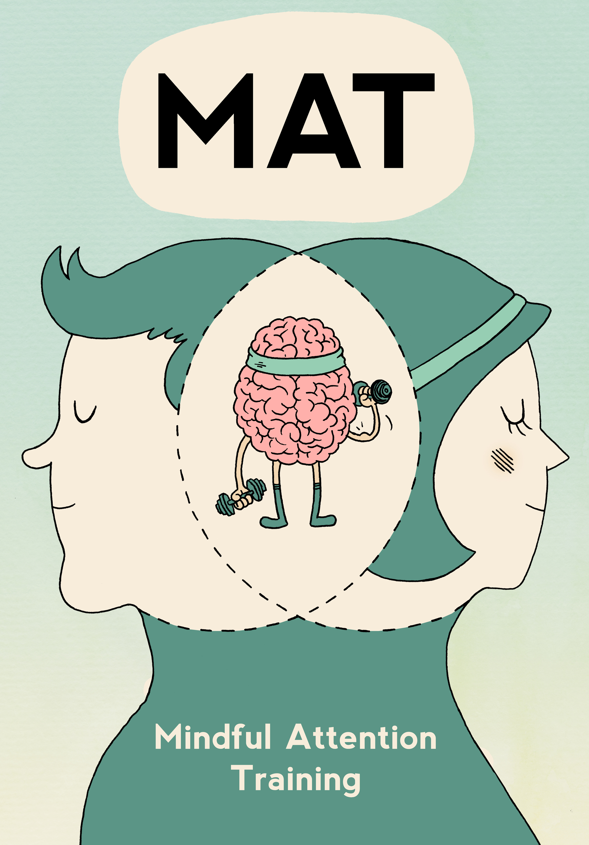

Slide 9
Mindfulness
A Two-Component Model
Paying attention in the present moment
In a particular way (curiosity, openness, acceptance)

Slide 10
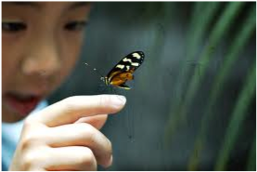
MINDFULNESS
“Paying attention to what is happening, here and now,
both outside and inside us, with kindness and curiosity.”
Dr Amy Saltzman

Slide 12
What is mindfulness?
“You feel like a red rose slowly blooming
and taking life in.”
(Year 6 student)

Slide 13
Mindfulness for Children and Adolescents
What is mindfulness?
How can we create relevancy?
What is the evidence base?
How can we share mindfulness using
age-appropriate language and activities?

Slide 15
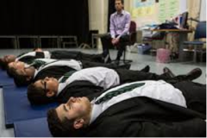
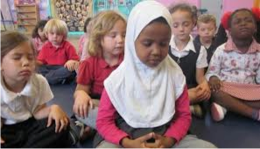
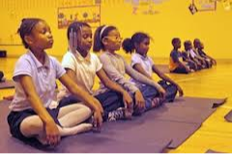
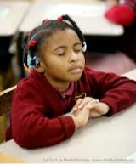
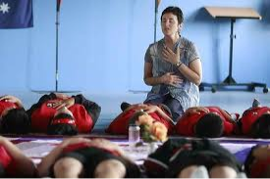
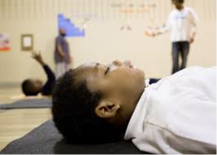
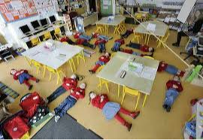
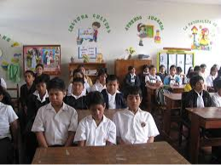
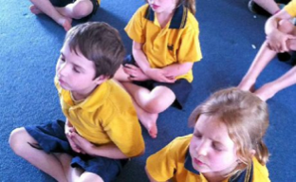
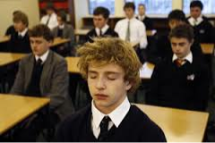
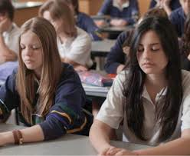

Slide 16
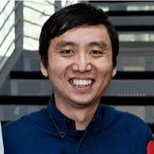
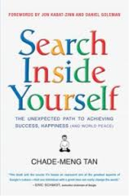
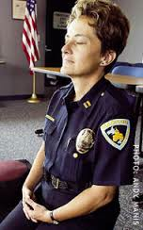
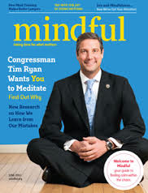
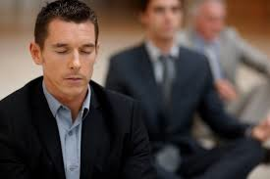

Slide 17
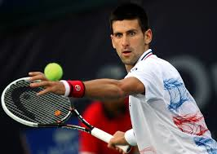
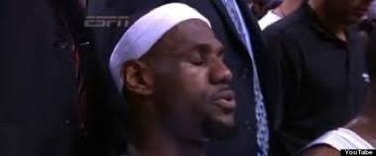
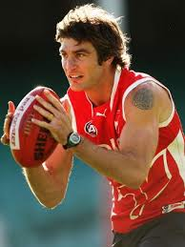
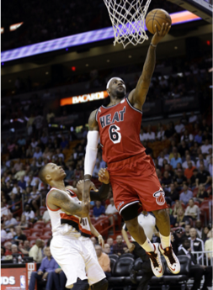
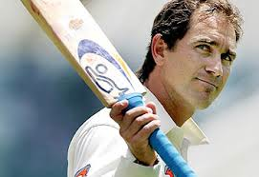

Slide 18
Mindfulness for Children and Adolescents
What is mindfulness?
How can we create relevancy?
What is the evidence base?
How can we share mindfulness using
age-appropriate language and activities?

Slide 19
MINDFULNESS FOR ADULTS
30+ years of peer reviewed scientific research documenting a range of benefits:
MENTAL HEALTH
Eg depression relapse prevention, anxiety, stress, addiction
NEUROSCIENCE
Eg structural and functional changes, neurogenesis
CLINICAL
Eg pain management, reduced allostatic load, possibly slower ageing
PERFORMANCE
Eg leadership, sport

Slide 20
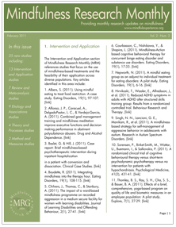
Mindfulness Research Monthly
American Mindfulness Research Association
https://goamra.org

Slide 21
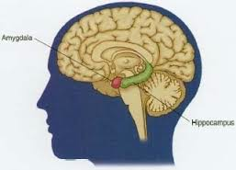
Participation in 8 week MBSR course -
Increased grey matter density in the hippocampus: strongly involved in learning and memory.
Decreased grey matter density in the amygdala:
area of brain most associated with emotional reactivity and fear.
Hölzel et al, 2011

Slide 22
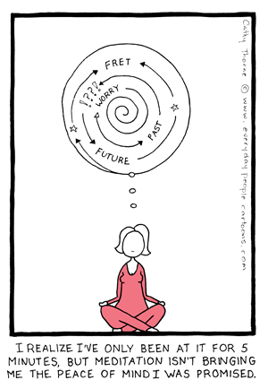

Slide 23
CURRENT MINDFULNESS RESEARCH - YOUTH
ACADEMIC SKILLS
Mindful attention training can improve:
Attention – Working Memory – Executive Function – Self-regulation
MENTAL HEALTH
Mindful attention training is an effective intervention for:
Depression – Stress and Anxiety – Well-being

Slide 24
ACADEMIC SKILLS
Mindful attention training:
Reduces mind wandering and distraction.
Supports corresponding improvement in working memory
and also in test scores.
Mindfulness is “an effective and efficient technique for improving cognitive function with wide-reaching consequences.”
Mrazek et al, 2013

Slide 25
ACADEMIC SKILLS
Mindfulness-based Kindness Curriculum supports improved
academic results, self-regulation and pro-social behaviour.
Flook et al, 2015
See also:
Felver et al, 2014 (Attentional Self-regulation)
Flook et al, 2010 (Executive Function)
Napoli et al, 2005 (Attention)

Slide 26
MENTAL HEALTH
School-Based Mindful Attention Training
Secondary School Students
Significant intervention effects shown (at 3 month follow up) in each of the 3 outcome measures of depression, perceived stress, and wellbeing.
Kuyken et al, 2013
Mindful attention training was shown to be able to both reduce and prevent depression in adolescents.
Raes et al, 2013
See also: Semple et al, 2005

Slide 27
Mindfulness in Education Research Highlights
greatergood.berkeley.edu

Slide 28
“Mindfulness means to me, to draw my attention inwards, to my thoughts, feelings and emotions. It helps me to calm down in stressful situations, choose and make better decisions when given a hard choice or just stopping to relax or appreciate what we have. To be mindful, it feels calming and equal inside you. You feel attentive and switched on. It is really helpful to be mindful.”
(12 year old student)

