Slide 1
Mindfulness for Children and Adolescents
What is mindfulness?
How can we create relevancy?
What is the evidence base?
How can we share mindfulness using
age-appropriate language and activities?

Slide 2
Translate the scientific research into practical activities which overtime will build a toolbox of life skills.

Slide 3
TOOLBOX
of component skills
learned cumulatively and customised
Year 7: Nuts and Bolts of Attention
Year 8: Character Foundation
Year 9: Emotional Framework
Year 10: Cognitive Windows
Years 11-12: Building for Beyond

Slide 4
YEAR 9: EMOTIONAL FRAMEWORK
Term 1: Awareness
1.
Understand
the role of
emotions
2.
Increase
awareness of
your emotions
3.
Accept
your
emotions
4.
Recognise
resistance
5.
Cultivate
positive
emotions
Term 2: Autonomy
1.
Manage
difficult
emotions
2.
Explore
self-regulation
strategies
3.
Control
unhelpful
impulses
4.
Cultivate
positive
emotions
5.
Be
your own
good friend
Term 3: Resilience
1.
Understand
resilience
as a skill
2.
Explore
external and
internal factors
3.
Recognise
memory
is recreated
4.
Activate
agency
5.
Cultivate
self-care

Slide 5
PEDAGOGY:
Small moments of awareness repeated Often

Slide 6
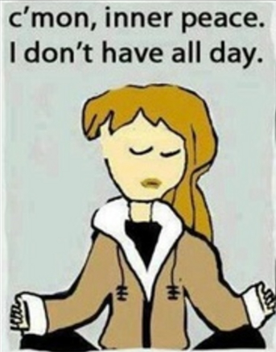

Slide 7
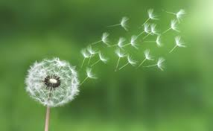
Mindful Punctuation Marks:
A brief of moment of pause.
Like a breath between words,
mindfulness can be a breath between activities.

Slide 8
www.headspace.com
www.smilingmind.com.au

Slide 9
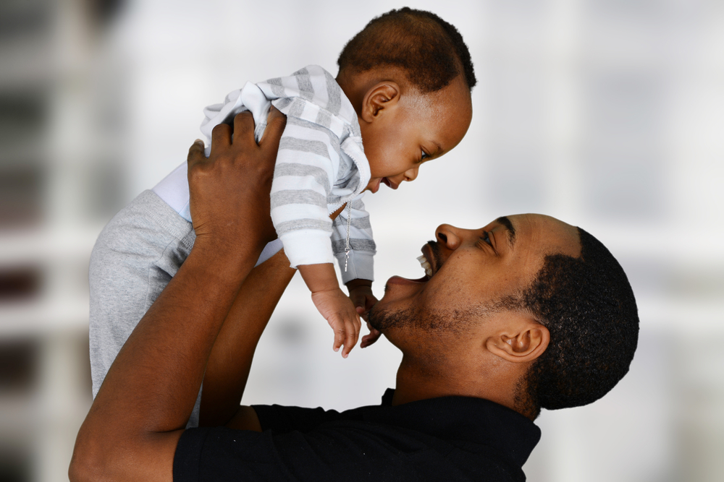
“Attention is the . . . purest form of generosity.”
Simone Weil

Slide 10
Attachment: The Four “S’s”
Daniel J. Siegel, M.D.
Seen
Soothed Safe
Secure

Slide 12
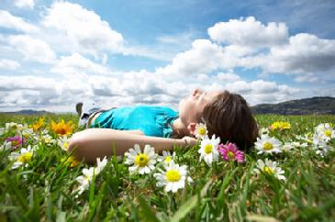
Fostering children’s natural mindfulness . . .

Slide 13
Understanding the teenage brain . . .

Slide 14
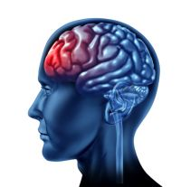
PREFRONTAL CORTEX
High level functions:
Including intention to pay attention, emotional regulation, body regulation, fear modulation, decision making etc.
Does not fully mature until approximately 25yo.

Slide 15
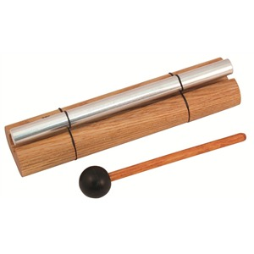
MINDFUL LEARNING
Two dimensions:
Attention and self-regulation

Slide 16
MENTAL GYM
Training the ‘muscle’ of attention
Distraction -> Notice -> Let go ->
Focus -> Refocus

Slide 17
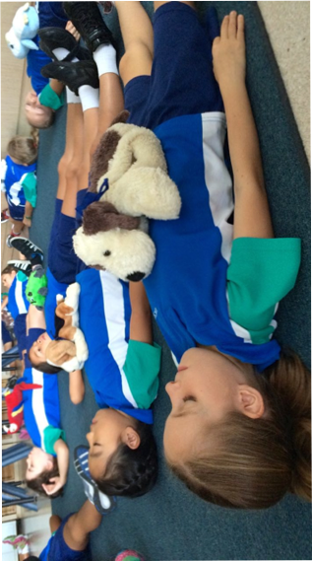

Slide 18
TEST
Take a moment to pause.
Exhale slowly a few times.
Soften your face, mouth, jaw.
Tell yourself quietly and kindly:
Right now, I’m doing the best I can.

Slide 19
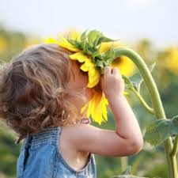
WELL-BEING
A skill that can be learned

Slide 20
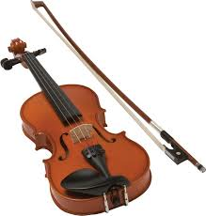
“Well-being can be learned. It is very analogous to skills training: it is through repeated practice that connections get established in the brain that support the new skill or habit.”
Professor Richard Davidson

Slide 21
MINDFUL WELL-BEING
Dual dynamic:
(Emotions and Thoughts)
Accept and manage the difficult
Cultivate the positive

Slide 22
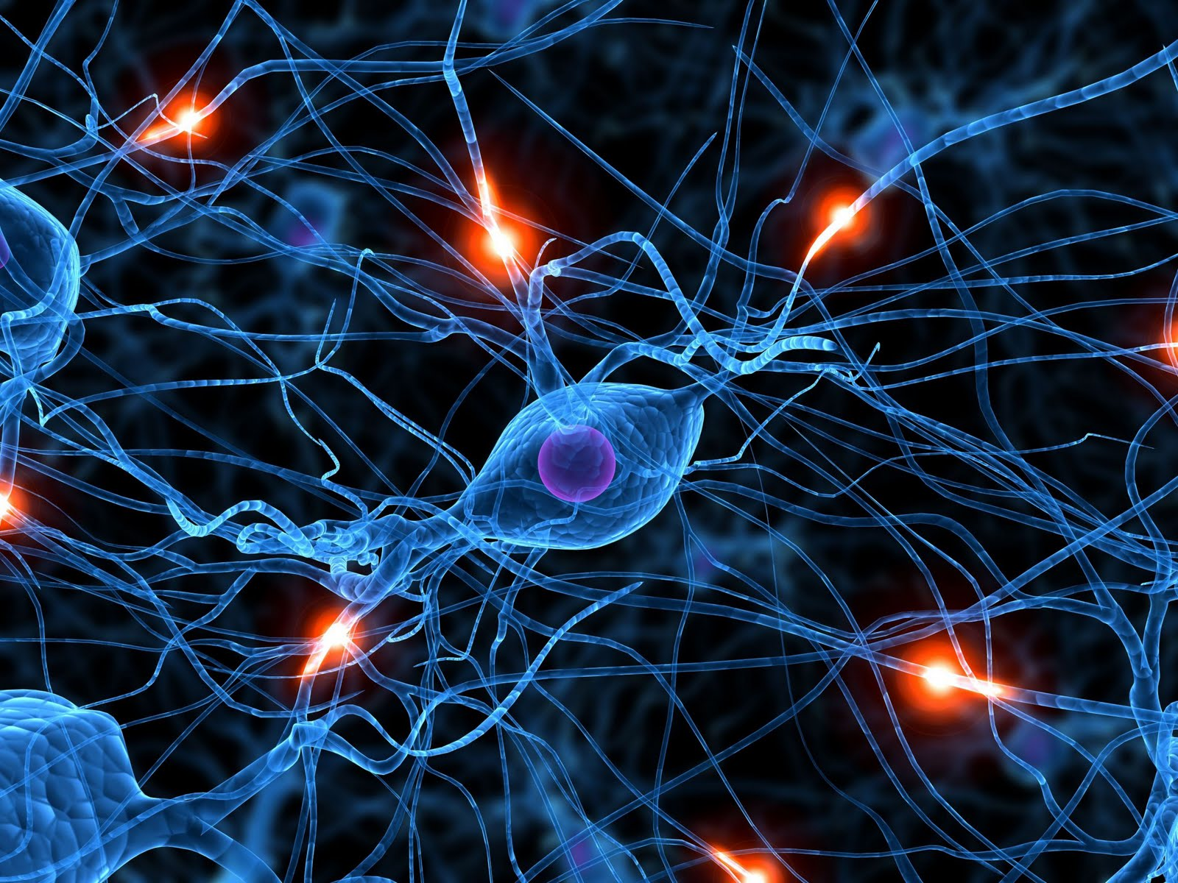
“Neurons that fire together, wire together.”
Dr Donald Hebb
What you pay attention to, gets stronger.

Slide 23
‘Take in the Good’
Developed by Rick Hanson, Ph.D.
See Hardwiring Happiness, 2014

Slide 24
All the flowers of all the tomorrows are in the seeds of today.
Indian proverb

Slide 25
Thank you
Fiona Gauntlett
www.mindfulness-seed.com.au
0412 020 687

