Slide 1
TEEN SLEEP
.

Slide 2
THE PROBLEM IS
Teenagers need 9 to 10 hours sleep.
Teenagers get 7 to 8 hours sleep, some even less.
Teenagers need more sleep than children or adults.
Teenagers produce melatonin later in the night

Slide 3
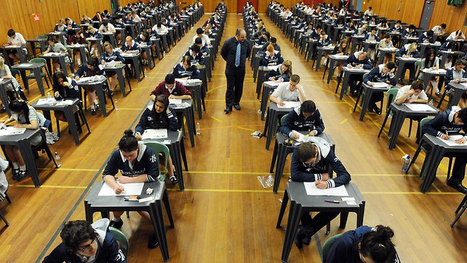
WHAT DO EXAMINERS WANT?
.

Slide 4
.
.

Slide 5
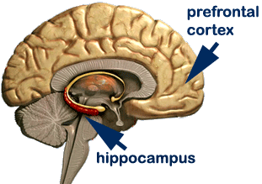
.
.

Slide 6
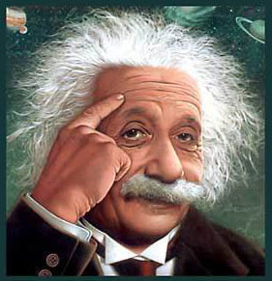
HIGHER ORDER THINKING
.

Slide 7
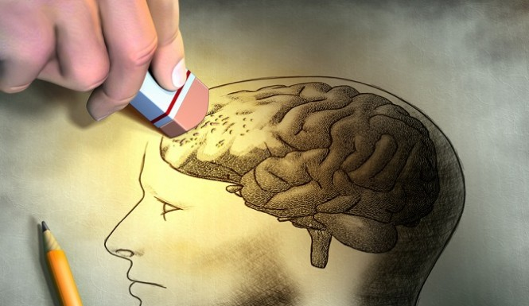

Slide 8
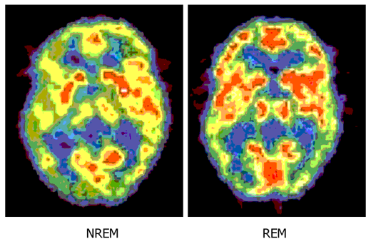
.
.

Slide 9
COGNITIVE POWER
Take a nap - and improve your memory
A six minute nap can improve your ability to remember word lists etc
Sleep may activate the process of memory consolidation

Slide 10
CONSOLIDATE YOUR MEMORY
.

Slide 11
MENTAL HEALTH
.

Slide 12
.
.

Slide 13
Lower levels of depression and anxiety.
Better overall moods.
Lower propensity for risk-taking behavior.
Lower incidence of drug and alcohol abuse.

Slide 14
A study of 20,000 17-24 year olds in W.A. found those getting 5-6 hours sleep a night were far more likely to have mental health problems
A study of 15,000 American teenagers found those going to bed after midnight were 24% more likely to suffer from depression than those in bed at 10pm

Slide 15
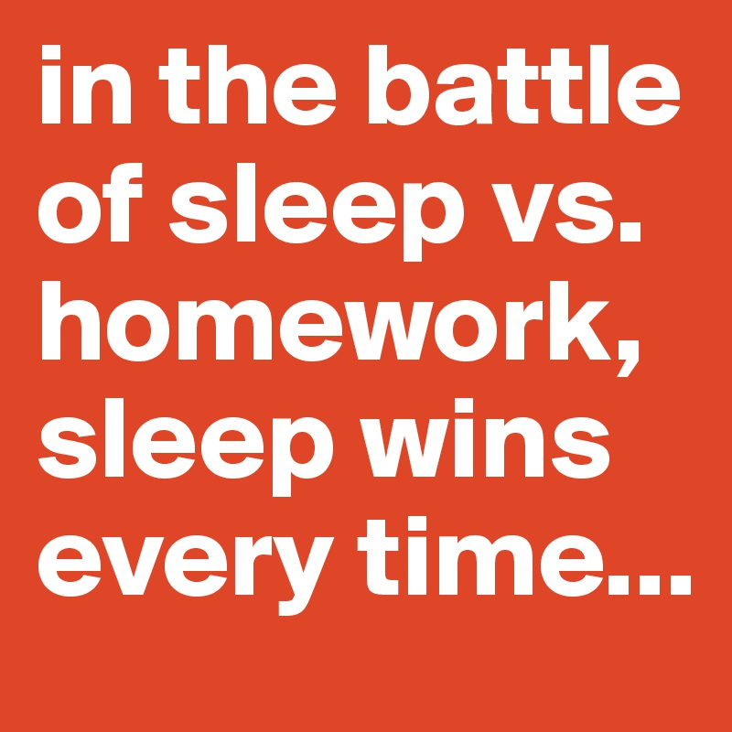
SLEEP VS HOMEWORK
more homework = less sleep but more sleep = less homework

Slide 16
PHASE 1
Coffee and Chocolate
.
PHASE 2
I’ll get up early
.
PHASE 3
Who needs sleep
.
PHASE 4
I’ll do it tomorrow
.
PHASE 5
The dog ate my homework

Slide 17
.

Slide 18
sport
Improved Skill
Speed Strength and Endurance
Build Muscle Mass
Mental toughness and focus

Slide 19
.
.

Slide 20
THE SLEEP DIET
Tired bodies and brains crave more calories.
Lack of sleep affects metabolism by changing levels of appetite regulating hormones such as leptin and ghrelin.
A recent study shows…

Slide 21
THE SLEEP DIET
Teens who slept less than 8 hours a day consumed, on average, 1,968 calories a day
Teens who slept 8 hours or more consumed about 1,723 calories a day.
Sleep deprived teens consumed more calories from fat.

Slide 22
HOW MUCH SLEEP ARE YOU GETTING?
.

Slide 23
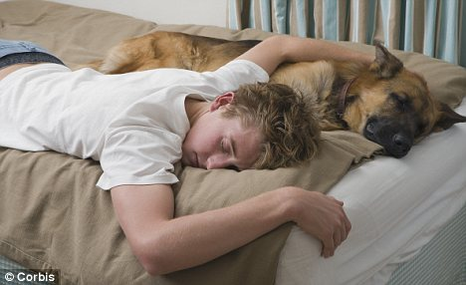
SLEEPING PROBLEMS
.

Slide 24
CAUSES OF SLEEP DEPRIVATION
Over-scheduling.
Over-stimulation - too much white/screen light effects Melatonin levels - sleep cycles are set by light coming into eyes.
Lack of routine - late night weekends are like jetlag.
Self-perpetuating cycle (cortisol production).
Technology - Phones and Computers

Slide 25
“I’m so good at sleeping I can do it with my eyes closed”: anon
.

Slide 26
How to get a good night’s sleep
.

Slide 27
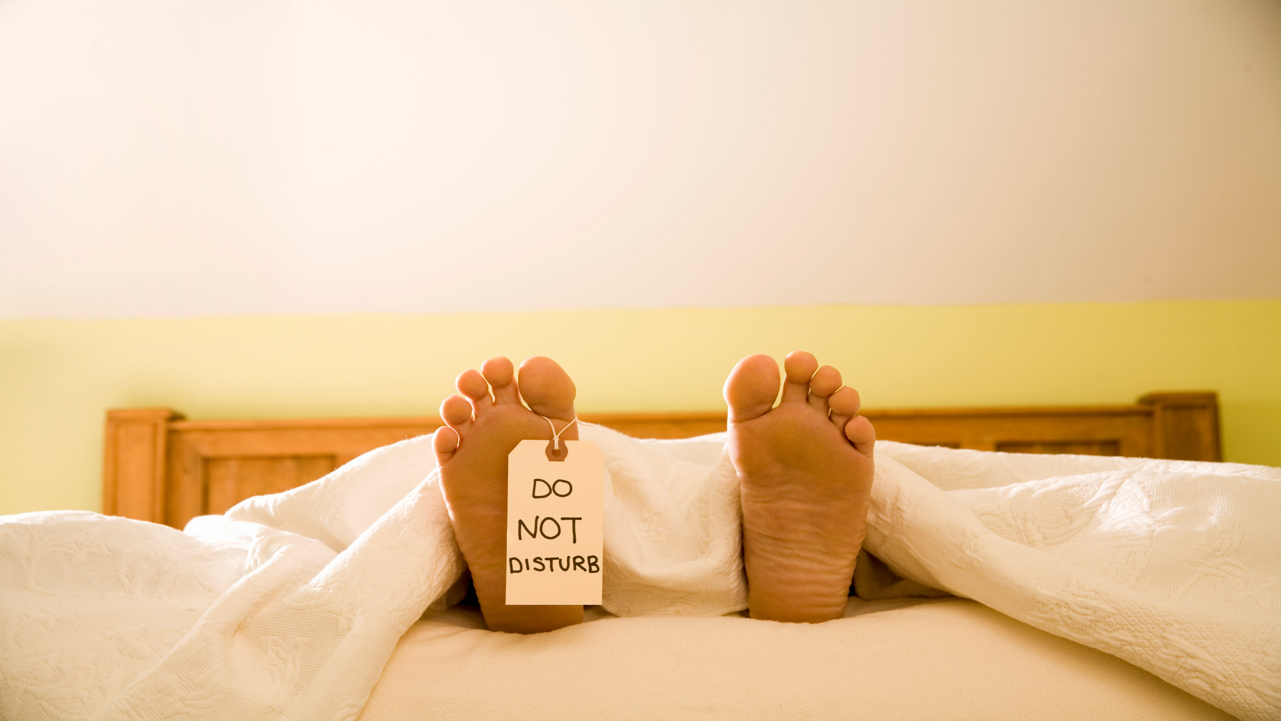
Good sleep hygiene
.

Slide 28
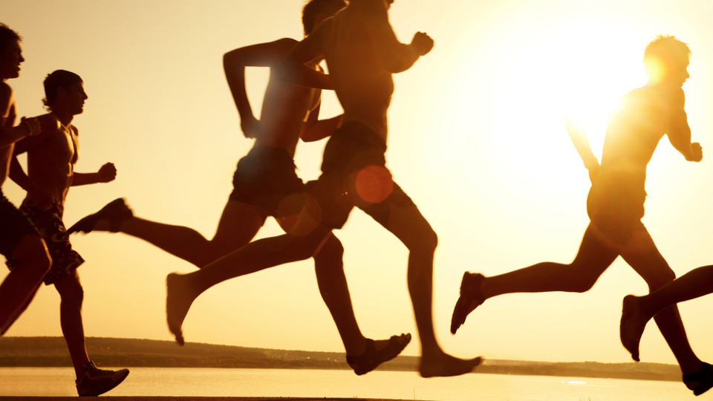
Be physically active
.

Slide 29
Be physically tired
.

Slide 30
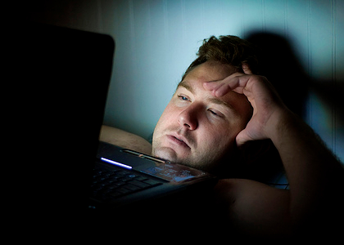
Put away the tech
.

Slide 31
Change your body clock
.

Slide 32
Morning light
.

Slide 33
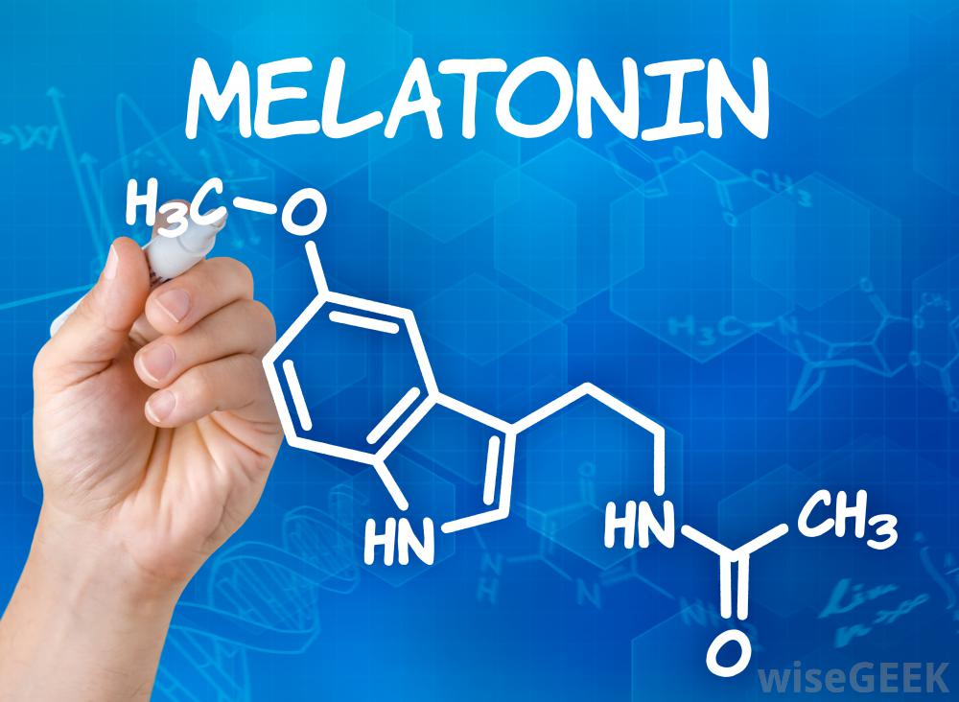
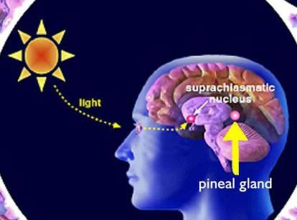
ONIN
.

Slide 34
WARM MILK
.

Slide 35
WRITE IT OUT
.

Slide 36
Calm your mind
.

Slide 38
The quiet mind sleeps best
.

Slide 39
It’s in your hands
You have a lot to do – it’s not easy to find the time to sleep.
Make an informed decision, and manage your time well.
Sacrificing sleep for study is a trade off - it has costs.
You can perhaps have the best of both worlds - be efficient, and achieve your best.

Slide 40
MELATONIN
.

