Slide 1
Extended Essay Introduction
St Leonard’s College Year 11
Monday 6 August 2018
Presenter: Jenny McArthur

Slide 2
Initial stages
How do you feel about starting the EE?
What issues and questions do you have?
What do you think you will learn from this process?

Slide 3
Choosing a topic
Motivation
Choose a topic that really interests you.
What are you passionate about? Give me some examples.
History examples
The abolition of slavery
The film Rabbit Proof Fence
Lafayette, a hero of the American and French Revolution.
The fall of the Inca Empire
The forts around Port Phillip Bay
Salem witch trials

Slide 4
Narrowing the topic down to a question
Wording of the question
Use a command term that will allow your topic to be explored fully – How, Why, To what extent
Avoid terminology that will lead to narrative/descriptive writing.
Make sure it is a manageable topic. Set a timeframe.
History EEs must be mindful of the 10 year rule – 2008 is the cut off.
Make sure it will allow for discussion and analysis of a central issue(s).
Make sure it will allow you to discuss different perspectives about the chosen issue.

Slide 5
Examples of unsuitable History topics
Identify why these are unsuitable.
How have Disney Princesses become more feminist over time?
The history of skateboarding.
To what extent do the changes in women’s fashion reflect their changing status in society?
How is the film Saving Private Ryan true to history?
Explain why Sandringham became a village and then a suburb.
How has terrorism changed the world?

Slide 6
Examples of successful History EE questions
To what extent were successive Australian governments’ policies of forcible removal of Aboriginal children from their families during the twentieth century an act of genocide?
Examine whether the economic effects of the abolition of slavery were as far reaching as predicted by the anti-abolitionists.
To what extent has A.O. Neville been demonized in his role as Chief Protector of Aborigines (1915-1935) and Native Commissioner of Affairs (1936-1940) due to shifting social values?
Explain why Lafayette, a hero of the French Revolution in 1789, was condemned a traitor by 1792.
To what extent was the fall of the Inca Empire due to internal weakness rather than Spanish conquest?

Slide 7
Examples from the EE Guide p77

Slide 8
Final EE should have title derived from your RQ Guide pp78-9

Slide 9
Planning
Create a Research Reflection Space (RRS)– notes about the EE process.
Draw a mind map of ideas.
Draw a flow chart of how your essay could develop to a conclusion.
Create a plan for your research.
Look for interesting and primary source material as well textbooks.
Write a timeline for research and writing to keep to the school deadlines.
Show and discuss all of the above with your supervisor.

Slide 10
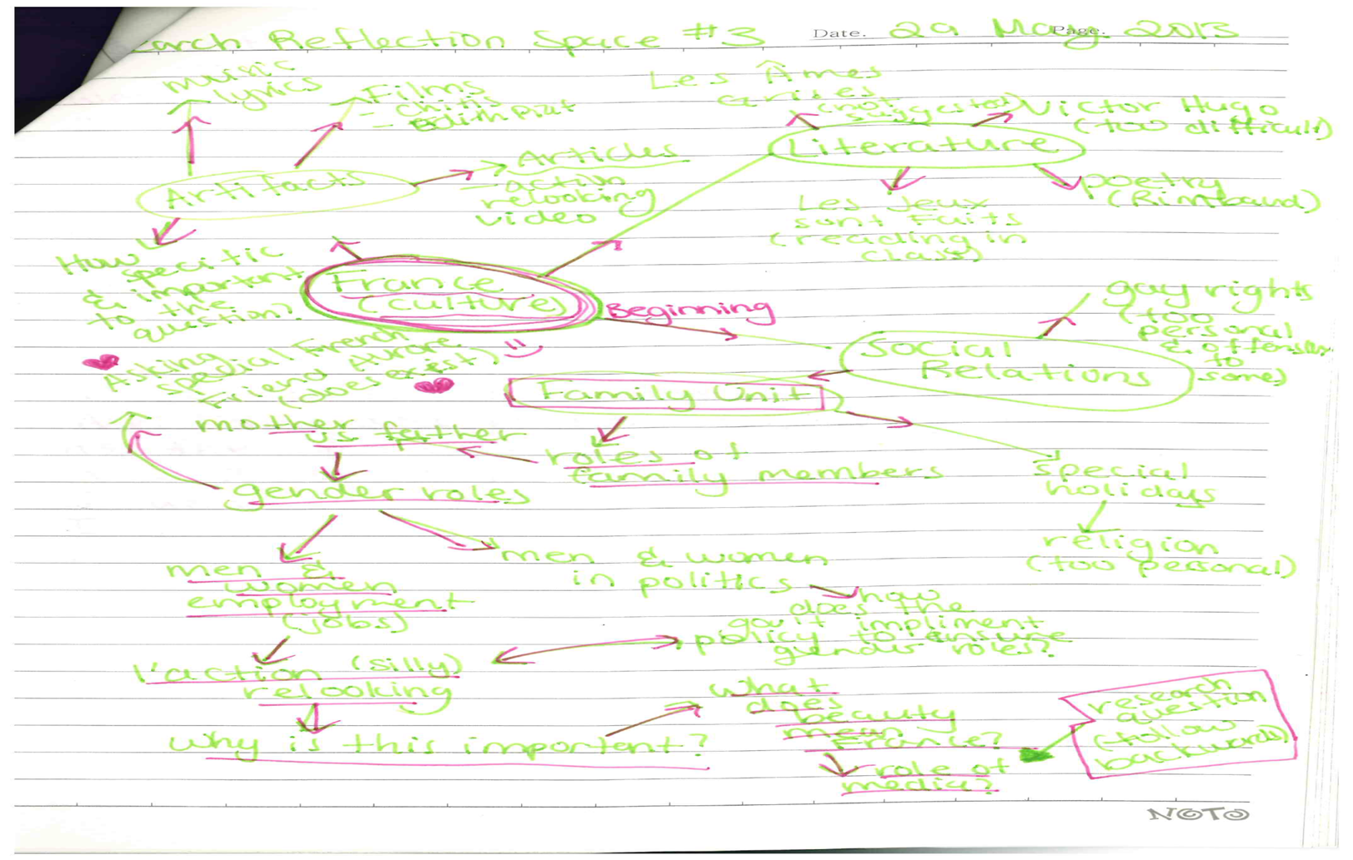

Slide 11
Importance of the Criteria
Have a hard copy of the criteria and keep it accessible at all times.
Always read the criteria before you even start the research for your essay.
Once you start writing read the criteria again and try to think about how they apply to the different sections of the essay.
Once you have written sections of the essay and your draft reread the criteria again and think about whether you addressed them.
Take the criteria along to your meetings with the supervisor and use them as a basis for discussion about what you have written.

Slide 12
Overview of EE criteria Guide p93

Slide 13
Keeping the Reflection in mind (Guide p40)
Reflection in the extended essay:
Focuses on your progress during the planning, research and writing process.
Intended to help with the development of your extended essay
Allowing you the opportunity to consider the effectiveness of your choices,
To re-examine your ideas and to decide whether changes are needed.
The emphasis is on process reflection,
Reflecting on conceptual understandings,
Decision-making, engagement with data, the research process, time management, methodology, successes and challenges, and the appropriateness of sources.
You can informally reflect throughout the experience,
But are required to reflect formally during the reflection sessions with your supervisor and when completing the Reflections on Planning and Progress Form (RPPF).

Slide 14
Meeting with the Supervisor
First Reflection session (1)- 20 -30 minutes.
Check in sessions – varying in length to discuss progress, ideas, any problems arising, resources, arguments.
Interim Reflection session (2) - 20 to 30 minutes.
More check in sessions
Submission of the draft and then supervisor feedback
Submission of final copy
Final Reflection session - Viva Voce (3) – 20 to 30 minutes

Slide 15
First Reflection Session
After this session you
Should understand the criteria,
Have discussed the topic and developed a workable draft research question,
Discuss possible resources,
Develop ideas and ask questions,
Think about possible issues and arguments,
Develop your plan of action and a timeline.

Slide 16
Interim reflection
After this session you
Should have a clear and refined research question and title,
Be able to identify the direction your research is taking,
Have an idea of the argument that you are developing,
Show that you have a sufficient range of resources,
Have a plan to complete the writing process.

Slide 17
Final Reflection –Viva Voce
Discuss how you have grown as a learner.
Share your personal experience.
Discuss your skills development - research skills, referencing, writing , editing, keeping to a timeline – and how important you think has been for the EE process and also for your future.
Discuss your development of conceptual understandings that you have acquired.
Discuss whether you found the whole process rewarding and personally significant.

Slide 18
Reflections on Planning and Progress Form (RPPF)
Make sure you keep notes about your perception of the whole EE process
Keep notes from your Reflections sessions with the supervisor.
The RPPF entries are written after each Reflection session with the supervisor.
Word count for RPPF is 500 words.
Look at the Samples sheet handed out and mark them against the criteria.

Slide 19
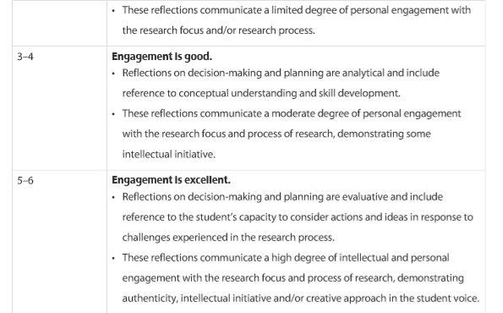
Criteria E for assessing RPPF form Guide pp100-101

Slide 20
Academic Honesty
Do not plagiarise – no copying material from books or from the internet, no cut and paste from Wikipedia or other internet sources.
No cheating - copying work from past or present students or friends and relatives.
No one else can write your EE.
Don’t make up stuff.
Always acknowledge your quotations and also ideas or points you get from books that you may write in your own words.

Slide 21
Referencing and Bibliography
Acknowledgement of your quotations and sources is crucial throughout the essay.
Referencing must be consistent throughout the EE and follow a standard convention.
The Bibliography must include all the sources you have used and follow a standard convention.

