Slide 2
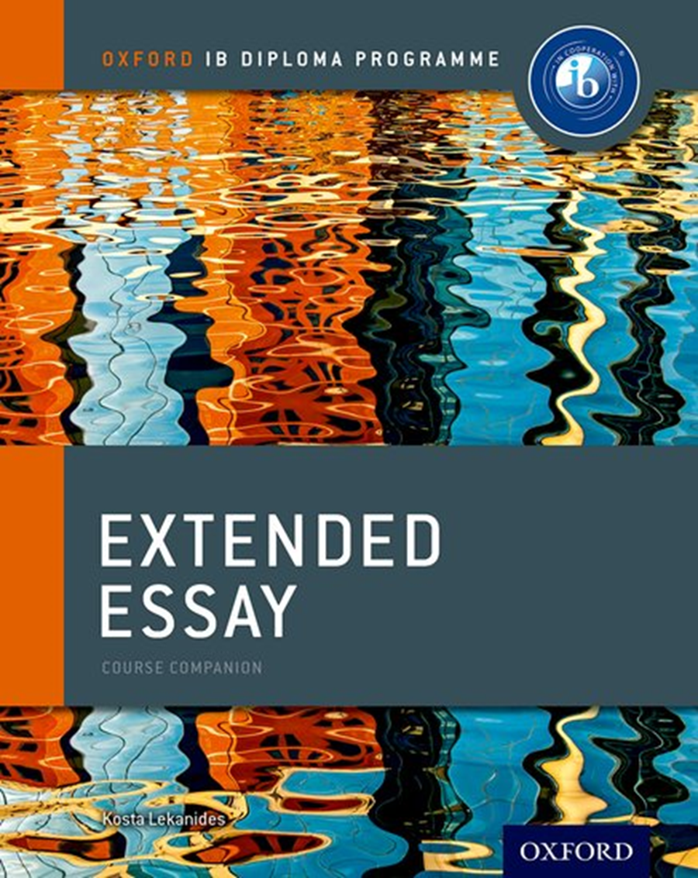
Reflections on Planning and Progress Form (RPPF)
The RPPF is two-page writable PDF for student and supervisor comments on MANAGEBAC.
The student RPPF entries are written after each Reflection session Share drafts with your supervisor. Second Reflection should be submitted with your draft.
Word count for RPPF is 500 words. This is the total for ALL 3 reflections.
The supervisor writes comment at the end after the viva voce. The supervisor comment is not part of the assessment, but provides context for the examiner.
Submitted with your essay for external assessment – Criterion E (6 marks)

Slide 3
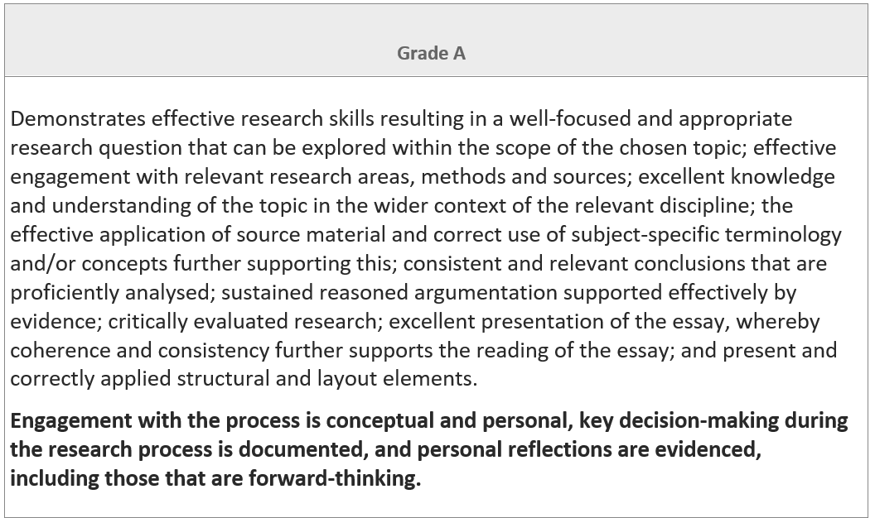
EE Guide p.102
This bold section should guide your reflections

Slide 4
Mandatory reflection sessions Guide p55
First reflection session
This session should take place once the student has undertaken some preliminary research.
By the end of this session students should begin to formulate a working research question.
Interim reflection session
This session should take place once the student has undertaken a significant amount of their research and have begun to formulate an argument in response to their research question.
By the end of this session both the student and supervisor should feel confident that there is a clear and refined RQ; a viable argument; sufficient sources; and a clear understanding of the writing process.
Final reflection session
(Viva Voce)
This session should take place once the final version of the EE has been submitted.
It is a celebration of the completion of the essay and a reflection on what the student has learned from the process.

Slide 5
First reflection
Should include:
Draft research question and title
Initial readings/research/data found or to be collected
Be able to identify the direction their research is taking,
Have an idea of the argument that they are developing, what you are hoping to show through your research and writing

Slide 6
First Formal Reflection (EE Guide p.61)
This initial reflection session should be a dialogue between the student and the supervisor based on the
student’s initial explorations. It is recommended that the student sends their supervisor an outline of their research proposal ahead of the meeting in order to give the supervisor the opportunity to review their work. This will ensure that the reflection session is focused and productive.
Topics of discussion that should arise during this session include:
• a review of the requirements and assessment criteria for the subject
• a review of ethical and legal implications, if applicable
• a dialogue about possible approaches and any potential problems that might arise
• a discussion of strategies for developing the student’s ideas for the essay and expanding the research so that the essay starts to take form
• probing and challenging questions that will help the student focus their thinking; this should lead to
the development of the student’s working research question
• an outline of the next steps that the student should undertake in order to refine their question; this
should take the form of a research and writing timeline.

Slide 7
Example: Theatre
I was drawn to physical theatre as in class I was introduced to it through Kabuki. I initially considered writing about physical imagery but quickly realised that it was too broad of a topic, so I decided to relate it to a style of theatre I have seen performed on numerous occasions called Cirque Du Soleil. I am interested to find out how they use physical theatre in one of their most recent productions. The challenges appear to be finding enough video content to back up evidence. Through contacts and written articles, understanding how Cirque du Soleil incorporates physical theatre into the production of Kurios should be achievable.
Does it include:
Draft research question/title
Initial readings/research/data found or to be collected
Identify the direction their research is taking,
Suggest an argument that they are developing through your research / writing?

Slide 8
Interim Reflection
Refined research question and title
Comment on direction their research is taking – what is working; what changes have had to be made and why
Discussion of argument that you are developing
Discussion of additional key resources and data – what have you learned?
Have a plan to complete the writing process.

Slide 9
Interim Reflection (EE Guide p.62)
This session is a continuation of the dialogue between supervisor and student in which the student must demonstrate the progress they have made in their research. They must also be able to discuss any challenges they have encountered, offer their own potential solutions and seek advice as necessary.
During this session the supervisor might discuss:
• a completed piece of sustained writing from the student in order to ensure that they understand the
academic writing requirements, including referencing formats
• whether an appropriate range of sources has been accessed and how the student is critically evaluating
the origin of those sources
• what the student now has to do in order to produce the full draft of their essay, and ways and means of
breaking down the task into manageable steps.
By the end of the interim reflection session both student and supervisor should feel satisfied that there is:
• a clear and refined research question
• a viable argument on which to base the essay
• a sufficient range of appropriate sources
• a clear vision for the final steps in the writing process.

Slide 10
Example: History
After extensive research, I began to understand the process of Australian settlement as something that occurred up until federation in 1901, meaning that I needed to establish a clear timeline to frame my RQ within. Furthermore, as I read in greater detail, particularly through book sources I realised that settlers’ perceptions differed. My original RQ almost inherently suggested that Terra Nullius was an excuse whereas the research I had done demonstrated the mindset of settlers as something more complex through primary accounts with additional historian commentary. This meant I altered my RQ to “To what extent was the ‘hunter-gatherer’ label assigned to Australian indigenous groups used an excuse in the informing of Terra Nullius and subsequently, the establishment of British colonies in Australia from 1788-1838?”. I am now looking forward to expressing what I have learnt throughout the drafting process, and refining what I have completed thus far.
Does it include:
Refined research question and title
Comment on direction their research: what is working; what changes have had to be made and why
Discussion of argument that they are developing
Discussion of additional key resources and data – what has been learned?
Have a plan to complete the writing process?

Slide 11
Final Reflection –Viva Voce
Discuss your growth as a learner
Discuss your skills development - research skills, referencing, writing , editing, keeping to a timeline – and how important they think these have been for the EE process and also for your future – be specific
Discuss your development of conceptual understandings on your particular title
Discuss what was particularly rewarding and personally significant.

Slide 12
Final Reflection & Viva Voce (EE Guide p.65)
The viva voce is a short interview between the student and the supervisor, and is the mandatory conclusion to the extended essay process. The viva voce is conducted once the student has uploaded the final version of their extended essay to the IB for assessment. At this point in the process no further changes can be made to the essay. The viva voce is a celebration of the completion of the essay and a reflection on what the student has learned from the process.
The viva voce is:
• an opportunity to ask the student a variety of open-ended questions to elicit holistic evidence of the student’s learning experience.
• an opportunity for the supervisor to confirm the authenticity of the student’s ideas and sources
• an opportunity to reflect on successes and difficulties encountered in the research process
• an aid to the supervisor’s comments on the Reflections on planning and progress form.
The viva voce should last 20–30 minutes. This is included in the recommended amount of time a
supervisor should spend with the student. (Part of the aim is to remind you of the substantial learning and work you have done towards completing your Extended Essay. Enjoy the meeting.)

Slide 13
Example: Biology
I am proud of my final essay and the work I have put into it. Throughout the research process, my critical analysis skills were improved as I learnt how to choose appropriate sources and considering what I needed to know to complete an effective investigation of my own. By completing the research phase early, I had time to reflect on my learning before completing the experiment and decide how to manage my time. However, I found that translating the new information I had learnt into concise language was challenging. Thus, I took my time to ensure I was effectively communicating my knowledge by frequently reviewing my work and comparing it to essential points that I had decided would have to be included. I was challenged during the experimental process given that it did not work three times; once for a lack of nutrients with the bacteria, the second time because of inappropriate growing environment and the final due to out of date materials. Although this was frustrating, without these setbacks I don’t believe I would have evaluated my choices for the essay with such detail, leading to insubstantial analysis of my investigation skills and of the results and method of the experiment itself. Overall, the EE has shown me that scientific research can be a rewarding process and I will consider pursuing it in the future.
Does it include:
Discuss growth as a learner
Discuss specific skills development - research skills, referencing, writing , editing, keeping to a timeline – and how important they think these have been for the EE process
Discuss development of conceptual understandings on the particular title
Discuss what was particularly rewarding and personally significant?

Slide 14
The viva voce: questions students might consider
Descriptive | Analytical | Evaluative
What did I do? How did I undertake my research? What were the problems I faced? Did my approach or strategies change throughout the process? What have been the high and the low points of the research and writing process? First reflection - OK | Was my research successful? If I changed approach or strategies during the process, why did I do this? What did I learn from the experience in terms of my understanding of the subject area and/or the skills needed to undertake research? How has my understanding of the topic and research process developed throughout the task? Interim Reflection - Focus | If I were to undertake this research again, would I do it differently – if so, why or why not? What has affected this? If I did do the research again would I change the theories applied, the methodological approach? Would this have led to a different outcome? What can I conclude from this? Were the strategies I used for undertaking my research the most appropriate for achieving my outcomes? What, if any questions emerged as a result of my research that I was not expecting? Would these questions influence my approach if I were to undertake the research again? Final Reflection - Focus

Slide 15
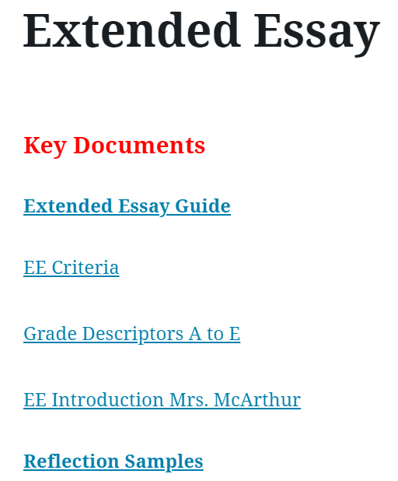
Reflection Samples
StLink
First
Interim
Final (Viva Voce)

Slide 16
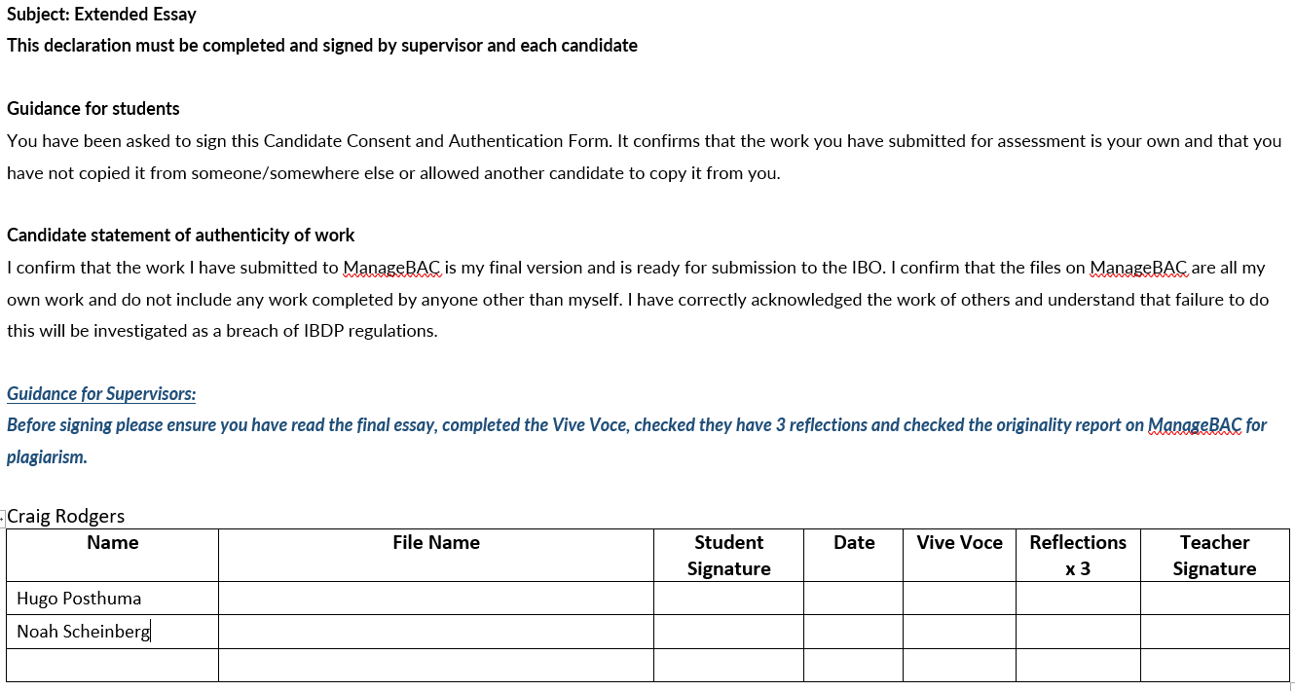

Slide 17
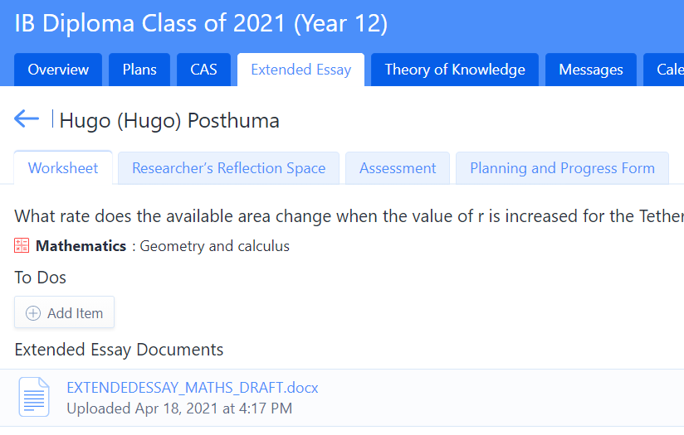
RPPF on Managebac

Slide 18
First Reflection (100-150 words)
Interim Reflection (150-200 words)
Final Reflection (200 words)
Word Count →

Slide 19
Dotting Is; Crossing Ts
Today = Now = This period
Complete draft of all reflections (even the final one)
Send reflections to your Supervisor
Arrange Viva Voce with your Supervisor; meet and discuss reflections
Soon after
Have your Viva Voce meeting with your supervisor
Thursday 29 July
Upload all 3 reflections to Managebac
Check and complete TOK forms: TK/PPD (oral) and TK/PPF (essay)
Complete and sign TOK Candidate Consent and Authentication Form
Complete CAS reflections
TOK Periods from August
Only students who have not completed CAS, TOK, EE or outstanding IAs are required to attend. A list of students required will be shared with Dr. McArthur and Ms. Sheehan each Wednesday afternoon.
Those not required may arrive at recess on Thursdays, signing in at SS office.

