Slide 1

Introduction to the
Extended Essay
24 July 2023

Slide 2
What is the Extended Essay?
The extended essay is a piece of independent research on a topic chosen by the student in consultation with a supervisor in the school.
It is presented as a formal piece of sustained academic writing containing no more than 4,000 words accompanied by a reflection form of no more than 500 words.
It is the result of approximately 40 hours of work by the student.
Students are supported by a supervision process recommended to be 3–5 hours, which includes three mandatory reflection sessions.
The third and final mandatory reflection session is the viva voce, which is a concluding interview with the supervising teacher.
Extended Essay Guide 2018 pp.34-35
Notes:
Reflections are completed on Managebac, separately from the EE itself
In reality, students spend at least double the number of hours. Research and experimentation

Slide 3
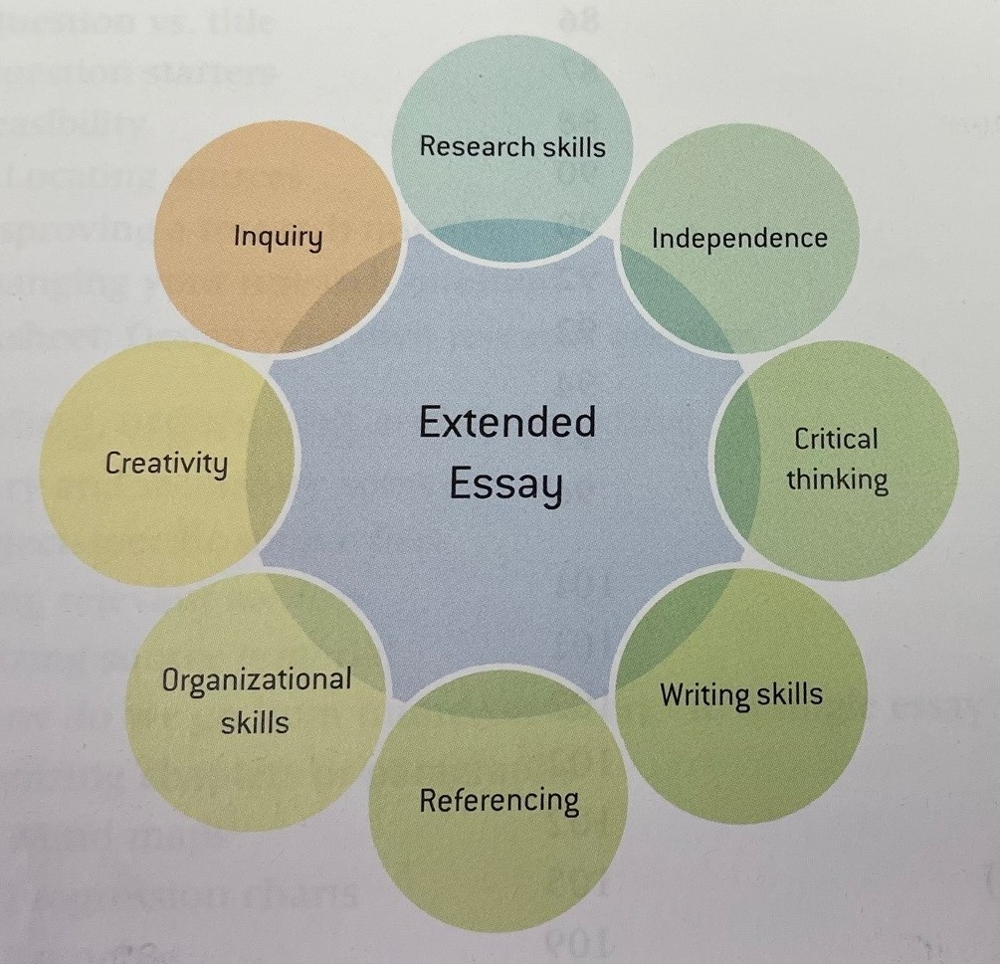
Chapter 1: The Basics
Structure
Words
Hours
Policies
Supervision
Submission
Assessment
Points Matrix
Do not Include
Test Page 7-8

Slide 4
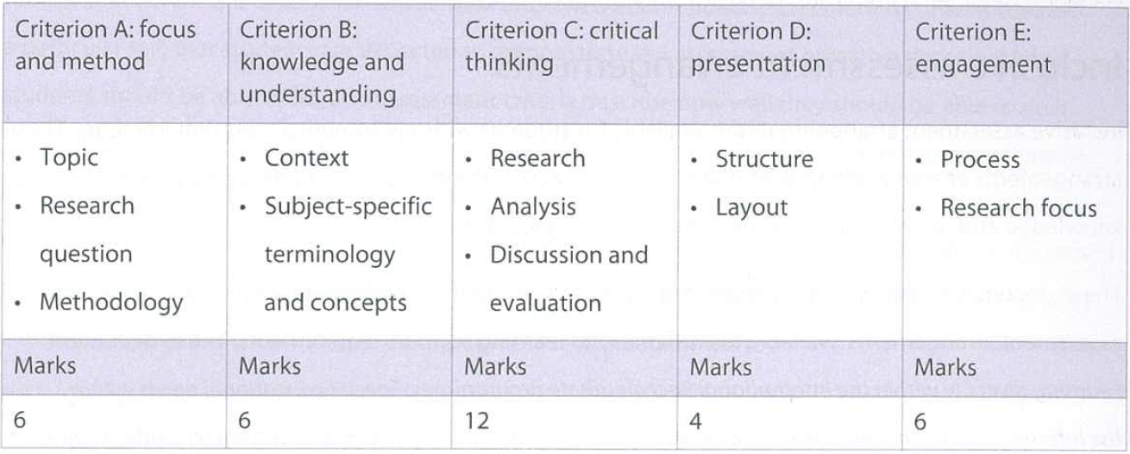
Extended Essay Criteria
Notes:
Criterion E – 3 reflections outside the essay; 1st one due term 4 year 11
An A in 2019 was 28-34, subject to review annually

Slide 5
What does an ‘A’ look like?
Demonstrates effective research skills resulting in a well-focused and appropriate research question that can be explored within the scope of the chosen topic; effective engagement with relevant research areas, methods and sources; excellent knowledge and understanding of the topic in the wider context of the relevant discipline; the effective application of source material and correct use of subject-specific terminology and/or concepts further supporting this; consistent and relevant conclusions that are proficiently analysed; sustained reasoned argumentation supported effectively by evidence; critically evaluated research; excellent presentation of the essay, whereby coherence and consistency further supports the reading of the essay; and present and correctly applied structural and layout elements.
Engagement with the process is conceptual and personal, key decision-making during the research process is documented, and personal reflections are evidenced, including those that are forward-thinking.
Notes:
Both your supervisors and I will refer back to this and other grade level definitions throughout the EE process

Slide 6
Some 2020 EE Titles
Biology: What is the effect of turbidity on the rate of photosynthesis in zostera muelleri?
Chemistry: The relationship between buffering capacity and well-researched titratable acidity
Economics: Impact privatisation of Victoria’s electricity market had on the price of electricity?
English Literature: Childhood innocence and adulthood within Samuel Wagan Watson’s poetry
Geography: How do the socioeconomic and educational characteristics of suburbs influence of the presence of Chinese populations over the past 20 years?
History: To what extent was the ‘hunter-gatherer’ label assigned to Australian indigenous groups an excuse for establishment of a British colony in Australia in the 1700s?
Mathematics: How the Mandelbrot set fractal shape is affected by changing the power of the real constant in the equation
Psychology: The role of sex hormones in risk taking behaviour in adolescents
SEHS: How the advancement of cycling technology has affected cycling speeds
Theatre: How do the original production elements seen in 'The Country Wife' (1675) influence a restoration of the same play?
Visual Art: Animal anthropomorphism in western animation
Notes:
You can choose to write an EE in any of your 6 subjects.

Slide 7
Chapter 2: Getting Started
Subject
Initial Research Question / Working Title
Limiting Factors
Accuracy • Experiment • Reliability
Aspect • Factors • School
Author • Features • Skills
Case Study • Location • Society
Cause • Material • Technique
Effect • Methodology • Texts
Effectiveness • Process • Time Period
Focussed Research Question / Refined Title

Slide 8
Chapter 2: Getting Started - Examples
Subject: Physics
General idea: Particle vs. Wave Model for Light
Possible Initial Research Questions:
In what ways is the particle model better than the wave model for describing light? – comparison between theories
Where does the particle model for light succeed and where does it fail? – interrogation of one theory from different perspectives
How does Young’s Double-Slit Experiment verify particle model for light? – experimentation compared to research
How could each of these initial research questions be improved?
Feasibility Check Page 23

Slide 9
Your Turn
For your first preference subject, have a go at writing one or two initial research questions including potential limiting factors
Subject Preferences Survey
2 subjects
Include possible topic/research questions – this helps teachers decide allocations
Student-supervisor combinations recommended by faculty teams, confirmed by IBDP Co-ordinator via email
Close date Monday 31 July 4:00 p.m.
Extended Essay (Oxford)
Read Chapters 1 & 2
Notes:
You should all have and begin to read the Extended Essay (Oxford) text: Chapters 1 and 2 a must

Slide 10

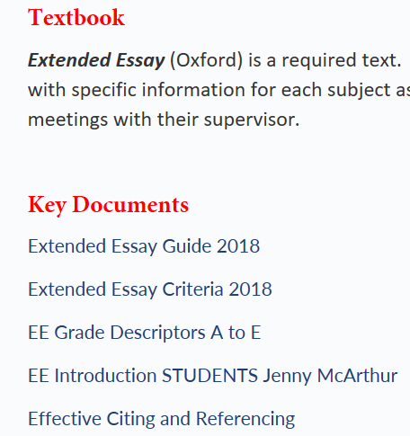
StLink – Extended Essay

Slide 11
Getting Started: The Process
Extended Essay (Oxford)
See Chapter 2
First meeting
Discuss topic and agree to preliminary RQ
Discuss and agree to preliminary reading/research/ experimentation ideas
Following the first meeting – get started!

Slide 12

The Research Process and Support

Slide 13
Term 3
Monday 24 July– Period 4 – Library – Introduction to Extended Essay: Subject Selection, Topic Selection, Research Selection
Our Library Resources: library staff, databases, referencing
XXX August – Period ?? – Library Research Question Development, Planning and Getting Started (hopefully you have commenced meetings planning and research by then)
Notes:
Dates TBC

Slide 14
Term 4
2 x periods – dates to be confirmed – planned reading, research and writing times
2 meetings with supervisor. Supervisors will be asked to report by Monday 16 October what reading/research/experimentation/writing students have completed. Those who have not achieved sufficient…
Reflection 1 completed uploaded to Managebac – Friday 27 October
2-3 x Transition program periods – December/January holiday plan to be complete ALL reading/research/writing. Plans to be uploaded to Managebac

Slide 15
Year 12, Term 1
Meeting with Supervisor by end of Week 2 to confirm holiday plan was completed. Meeting with IBDP Co-ordinator and communication with parents if not.
EE writing session - half day + 1-2 Maths SL sessions – 21 March TBC
Draft due – Day 1 Term 2 – this means planning to
  Meet as often as necessary with supervisor to plan sub-tasks to check off across the term; checking writing samples – am I on track/doing the right thing?
  Plan time to complete writing during term 1 and to complete full 4000 word essay in required format

Slide 16
Year 12, Term 2
Feedback from supervisor by Week 3
Reflection 2 completed uploaded to Managebac – end of Week 4
3 x periods – dates to be confirmed – EE writing sessions
FINAL EE DUE DATE – Monday Week 7
Viva Voce and Reflection 3 – Week 2, Term 3

Slide 17
Students are Encouraged to… (EE GUIDE p.48)
use the Researcher’s reflection space to prepare for reflection sessions
share excerpts from the Researcher’s reflection space with the supervisor during the reflection sessions
choose a subject, followed by a topic, and then think carefully about the research question for their essay
plan how, when and where they will find material and sources for their essay before deciding on the final topic and research question
plan for both the researching and writing, including extra time for delays and unforeseen problems
record sources as their research progresses using their Researcher’s reflection space rather than trying to reconstruct a list at the end
make the most of their supervision and reflection sessions by arriving prepared to discuss their work
have a clear structure for the essay before beginning to write – discuss with supervisor
check and proofread the final version of their extended essay
make sure that the version they submit for assessment is the final version with all sources correctly and consistently referenced

Slide 18

Key Support Questions?
Your Supervisor – research question, planning and review of progress; reflections
Ms. Holmes, Director of Library
Ms. Paterson, Research Librarian
Student Support Assistants (after school / weekends)
Problems or Questions?
Mr. Rodgers or Ms. Hawkins
Questions?

