Slide 1
Extended Essay Planning
Term 3 2023
163 South Road, Brighton East VIC 3187, Bunurong Country

Slide 2
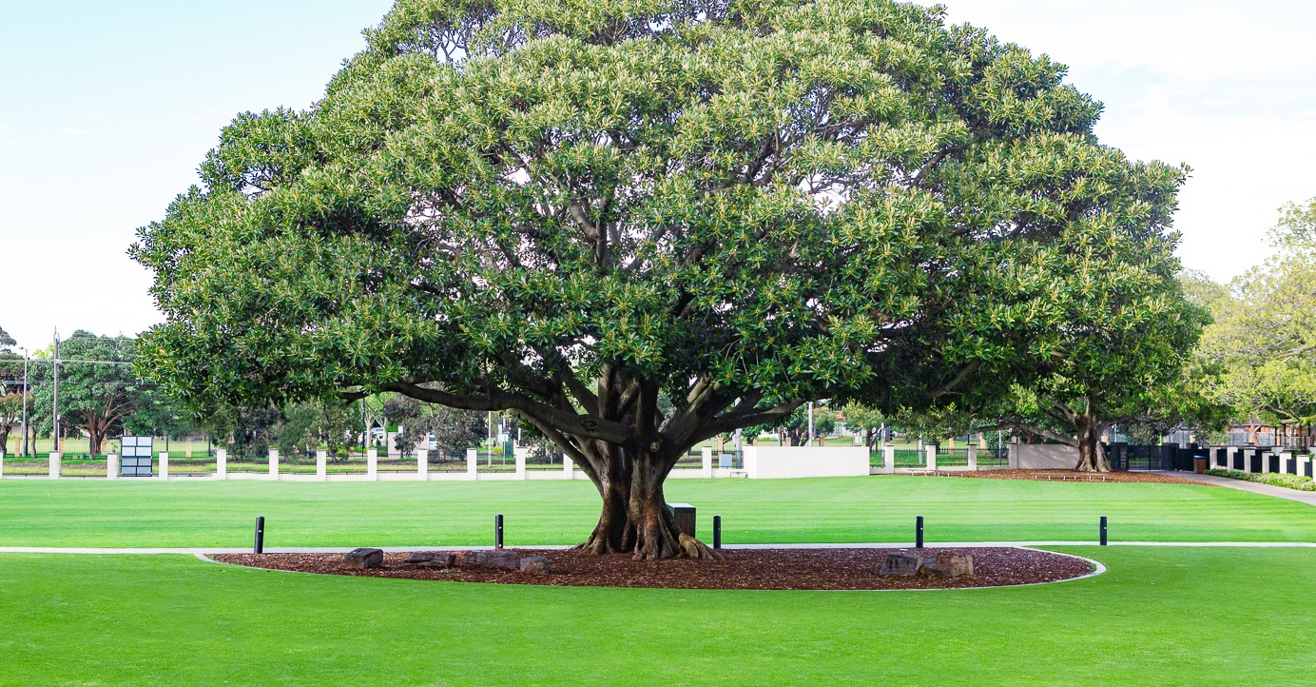
Acknowledgement of Country
We acknowledge the Bunurong People of the Kulin Nation as the Traditional Owners and Custodians of the land on which we meet.​
We pay our respects to their Elders, past, present and emerging, ​and to all Aboriginal and Torres Strait Islander peoples who are present with us.

Slide 3

Agenda
Your supervisor; your invaluable EE ally
Review of the Extended Essay
Developing a ‘good’ research question (Criterion A)
Developing a research plan (Criteria A & B)
Developing an experimentation plan (Criteria A, B & C)
EE Timeline 2023-2024

Slide 4

Supervisor Introductions
Great to hear that many of you have met with your supervisors and started to review your initial research question.
This session will help you focus your meetings.
If you have not arranged to meet with your supervisor, please do so asap – they’re waiting and eager to get started
It’s your essay, so you need to set meetings with clear agenda – what have you done?; what are you proposing to do next?; what advice do you need?

Slide 5
What is the EE?
4000 word research essay assessed under 5 criteria:
Criterion A: Focus and Method Is your Research Question clearly focussed?
Have you a clear plan of initial research (into what others have written/done)?
Have you clearly defined and then consistently executed a well described method?
Criterion B: Knowledge and Understanding
Have you demonstrated your understanding of key concepts/theories/perspectives of the research that directly relate to addressing your RQ?
Criterion C: Critical Thinking
Have you applied knowledge by comparing research and/or critically applying methods/theories to your own research/experimentation?
Criterion D: Presentation Correct, consistent formatting and referencing
Criterion E: Engagement 3 x reflections
Notes:
Today we will focus on criterion A, with some initial work planning for B

Slide 6
Refining Your Topic
Chapter 2: Subject and Topic.
Biology | To what extent is epilepsy caused by inheritance or infection? How does the presence and absence of melatonin regulate sleep cycles in humans?
Chemistry | The Synthesis of biodiesel from vegetable oils (WCO) and methanol in the presence of Calcium Oxide (CaO)
Economics | 1. To what extent has AirBnB and private services such as booking.com impacted the prices of the accomodation market in Gold Coast Australia? 2. How does the area in which tourist dependent hotels are located in Gold Coast Australia effect its demand/price?
Geography | To what extent does (a factor) affect an area's action on environmental conservation?- Local and foreign How does (a factor) affect the migration of people- internal and international
History | What was the role of literature in perpetuating cultural imperialism during the Spanish Civil war?
Notes:
Concepts identified which allows for some focus. This allowed supervisors to decide which they were able to/interested in helping in

Slide 7
Refining Your Topic
Chapter 2: Subject and Topic.
Lang & Lit / Literature | Analysis on The Virgin Suicides by Jeffrey Eugenides - portrayal of women through the lens of men
Music | To what extent do the funk elements of Bootsy Collins' discography shape 'Redbone' by Childish Gambino? (subject to develop over time, Bootsy Collins song likely to be 'Rather Be With You')
Psychology | Hypnosis and hypnotherapy, to what extent are those treatments reliable and effective
SEHS | The mechanics of throwing : A study into the most effective arm angle in pitching in baseball Investigation into muscle groups and which muscle groups will be optimised in order to achieve maximum velocity and command.
Visual Art | Racial stereotypes in western cartoons from the 30s and 40s
Notes:
Concepts identified which allows for some focus

Slide 8
Refining Your Research Question
Chapter 2: Question Starters & Limiting Factors
Biology | To what extent is epilepsy caused by inheritance or infection? How does the presence and absence of melatonin regulate sleep cycles in humans?
Chemistry | The Synthesis of biodiesel from vegetable oils (WCO) and methanol in the presence of Calcium Oxide (CaO)
Economics | 1. To what extent has AirBnB and private services such as booking.com impacted the prices of the accomodation market in Gold Coast Australia? 2. How does the area in which tourist dependent hotels are located in Gold Coast Australia effect its demand/price?
Geography | To what extent does (a factor) affect an area's action on environmental conservation?- Local and foreign How does (a factor) affect the migration of people- internal and international
History | What was the role of literature in perpetuating cultural imperialism during the Spanish Civil war?
Notes:
Most have question starters.
Green – specific limiting factors; purple non-specific factors which would need to be refined.

Slide 9
Refining Your Research Question
Chapter 2: Question Starters & Limiting Factors
Lang & Lit / Literature | Analysis on The Virgin Suicides by Jeffrey Eugenides - portrayal of women through the lens of men
Music | To what extent do the funk elements of Bootsy Collins' discography shape 'Redbone' by Childish Gambino? (subject to develop over time, Bootsy Collins song likely to be 'Rather Be With You')
Psychology | Hypnosis and hypnotherapy, to what extent are those treatments reliable and effective
SEHS | The mechanics of throwing : A study into the most effective arm angle in pitching in baseball Investigation into muscle groups and which muscle groups will be optimised in order to achieve maximum velocity and command.
Visual Art | Racial stereotypes in western cartoons from the 30s and 40s
Notes:
Most have question starters.
Green – specific limiting factors; purple non-specific factors which would need to be refined.

Slide 10
Research Focus (Criterion A)
Identify the specific research (focus), the basis for your Extended Essay
Identify the one (or two) research focus:
What…?
Experiment Methodology
Variables Parameters
Theory Philosophy
Problem Case Study
Research paper Author
Effectiveness Level of Reliability
Notes:
Maths problem/puzzle/enigma
Physics experiment/competing theories

Slide 11

Your Turn – 5 minutes
EITHER
Take this time, using your EE Course Companion to refine your current research question.
OR
Share your current research question with a partner.
Offer critical feedback to your partner:
Is the research question clear, refined to be achievable withing 4000 words?

Slide 12
Researching (Criterion B)
An effective research plan of attack - Your research plan must be shared, reviewed and confirmed with your supervisor.
Make a list of the research you will complete before your experimentation.
Make a plan to complete this research before the start of term 4 (Criterion A)
(30 minutes per week is enough time to carefully read and annotate one research paper)
Summarise your knowledge and understanding (Criterion B) from your research (papers). This will appear in your introduction along with your plan.
  What are the key terms, variables, notation, units? You may include a glossary, notation list following the index page at the start of the essay.
  How do different research papers define/describe problems, methods, theories? What/which of these will you use in your essay and why? Include only the research you will use in your final EE.
Notes:
Maths problem/puzzle/enigma
Physics experiment/competing theories

Slide 13
Experimenting (Criterion B & C)
An effective experimentation plan of attack - Your experimentation plan must be shared, reviewed and confirmed with your supervisor.
Make a plan of your exploration/experiment based on your research. (Criterion B) (You may do this concurrently with your research but you should not commit to this plan until you have completed the planned initial research – know your problem; know the experts and their knowledge background; what are the key terms, methods, points of agreement/disagreement, conclusions of research?; where are the problems to be solved?
What is your strategy to address your research question?
  What exactly will you do first, second, third, etc.
  While you can revise your plan, it is essential that you and your supervisor are clear about the order of your experimentation. This will aid you and your supervisor at meeting times.
Notes:
Maths problem/puzzle/enigma
Physics experiment/competing theories

Slide 14
Planning (Criterion A)
Devise a clear research and experimentation plan. Share with your supervisor.
What experimentation will you do?
  Map a plan of staged exploration:
    How will you go from the simple to the complex?
    How will you order the sequence of elements of your RQ for, exploration, examination and evaluation? (Criteria A, B, C)
Your plan should also include a specific statement on:
    How will your experimentation connect, compare/contrast, extend on existing research (what you’ve read)? (Criterion A) This will appear in your EE introduction.
Notes:
Maths problem/puzzle/enigma
Physics experiment/competing theories

Slide 15
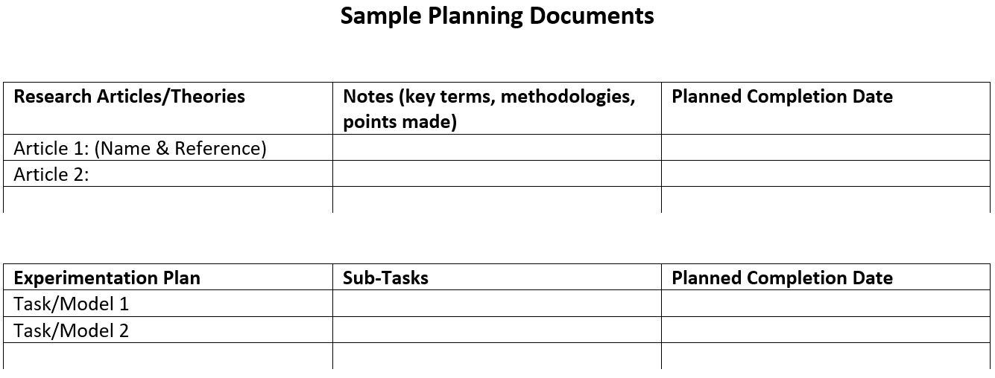
Sample Planning Document
Notes:
Concepts identified which allows for some focus

Slide 16
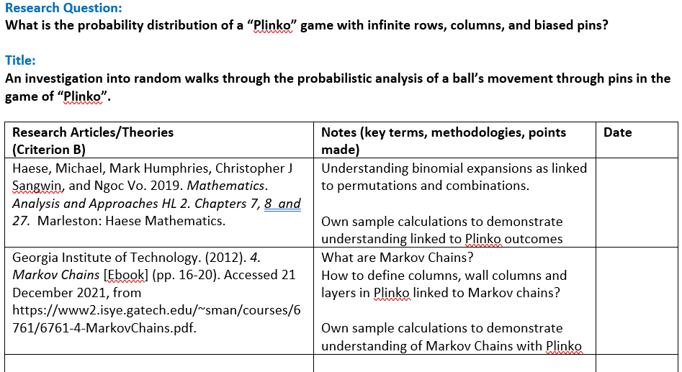
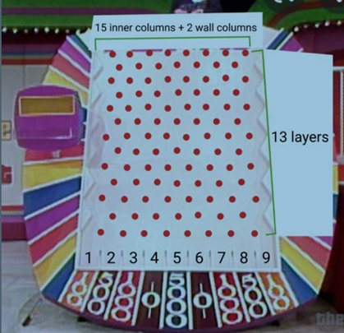
Sample Planning Document
Notes:
Concepts identified which allows for some focus

Slide 17
Sample Planning Document
Experimentation Plan | Sub-Tasks | Date
Review of Probability Distributions for unbiased ball drops in equally spaced columns and lists (Criterion B) | Demonstration of Pascal’s Triangle when there are no walls. Demonstration of probability distribution when there are walls
Computer simulation of Plinko; collection of data sample to compare with theoretical probabilities (Criterion B & C) | Develop computer simulation using Python (include coding in Appendix) Show sample simulation data Summarise test data for 100 trials Comment on similarities and differences with theoretical data.
Vary theoretical model and computer simulation to accommodate different thickness of pins and different spacings of pins by layer and list, including non-symmetrical spacings (Criterion B & C) | Revise computer simulation to vary (a) thickness of pins (b) spacing of pins (c) asymmetric spacing of pins Show sample simulation data Summarise test data for 100 trials for each of a, b and c Comment on similarities and differences with theoretical data.
Notes:
Concepts identified which allows for some focus

Slide 18
Critical Thinking (Criterion C)
Writing up your learning from research and experimentation
At all stages, what have you learned? How does learning address your RQ?
What has been confirmed/dispelled/qualified/quantified? How?
What new questions have arisen? What new elements/complications can be considered to further explore/better address your RQ? – additional complexity of models; moving from simple to more elaborate, real world considerations to better compare/examine/utilise research
What further comparisons/evidence/testing can be found/made?
What cannot/has not been answered? Why?
Keep a log of your thoughts as you research and experiment. Address these considerations in your final essay to demonstrate critical thinking, not just doing.
Notes:
Maths problem/puzzle/enigma
Physics experiment/competing theories

Slide 19
Your Turn…
Notes:
Concepts identified which allows for some focus

Slide 20
EE Timeline
Commit to 30 minutes per week
Follow YOUR plan
Meet sub-task dates
YOU arrange meetings and set the agenda
Read full EE Timeline; Post in your study area
Date | Student | Supervisor | IBDP Co-ordinator
Year 11 Term 3: MEETINGS & COMMENCING RESEARCH Recommended: 30 minutes on EE research/reading per week 2 meetings with your supervisor
Year 11 Term 4: MEETINGS, ANNOTATING & EXPERIMENTING Recommended: At least 3 meetings with your supervisor; 1 before Week 3
December – January Break | MUST COMPLETE all reading, research, interviews and experimentation MUST COMPLETE substantial writing of the Extended Essay draft. This means all research | Note and reinforce holiday expectations for students. This will make your role next year easier too. | Write to students, supervisors and parents informing them of Extended Essay expectations including checkpoint and Schoolbox report, Week 2, Term 1, Year 12.
Of all IBDP holiday homework, completing these Extended Essay requirements is the most important for setting up a successful year 12. Talk to your parents about how they can support you here.
Year 12 Term 1: DRAFTING Recommended: At least 3 meetings with your supervisor; 1 before Week 3
April Break | MUST COMPLETE draft Extended Essay, due Day 1, Term 2 | Note and reinforce holiday expectations for students. | Write to students, supervisors and parents regarding Extended Essay expectations including draft Extended Essay due date, Day 1, Term 2
Of all IBDP holiday homework, completing these Extended Essay requirements is the most important. Talk to your parents about how they can support you here.
Year 12 Term 2: EDITTING, SUBMITTING, CELEBRATING Recommended: Meet with your supervisor as soon as you receive your draft feedback

