Slide 1
Referencing
IB – Extended Essay

Slide 2
Today’s Outcomes
Today the aim is to cover the following points to assist you in your preparation for completing a successful Extended Essay.
Research Skills
Cornish Library and beyond
Referencing & its’ importance
Writing a Bibliography
That little bit extra!

Slide 3
Research Skills
https://stleonardscollege.libguides.com/crcpage/researchsupport
Brainstorming – locating key words
Know your topic – keep it relevant
Set yourself workable goals
Staying on track
Sources of Information – relevancy & authenticity.

Slide 4
Locating relevant sources

Slide 5
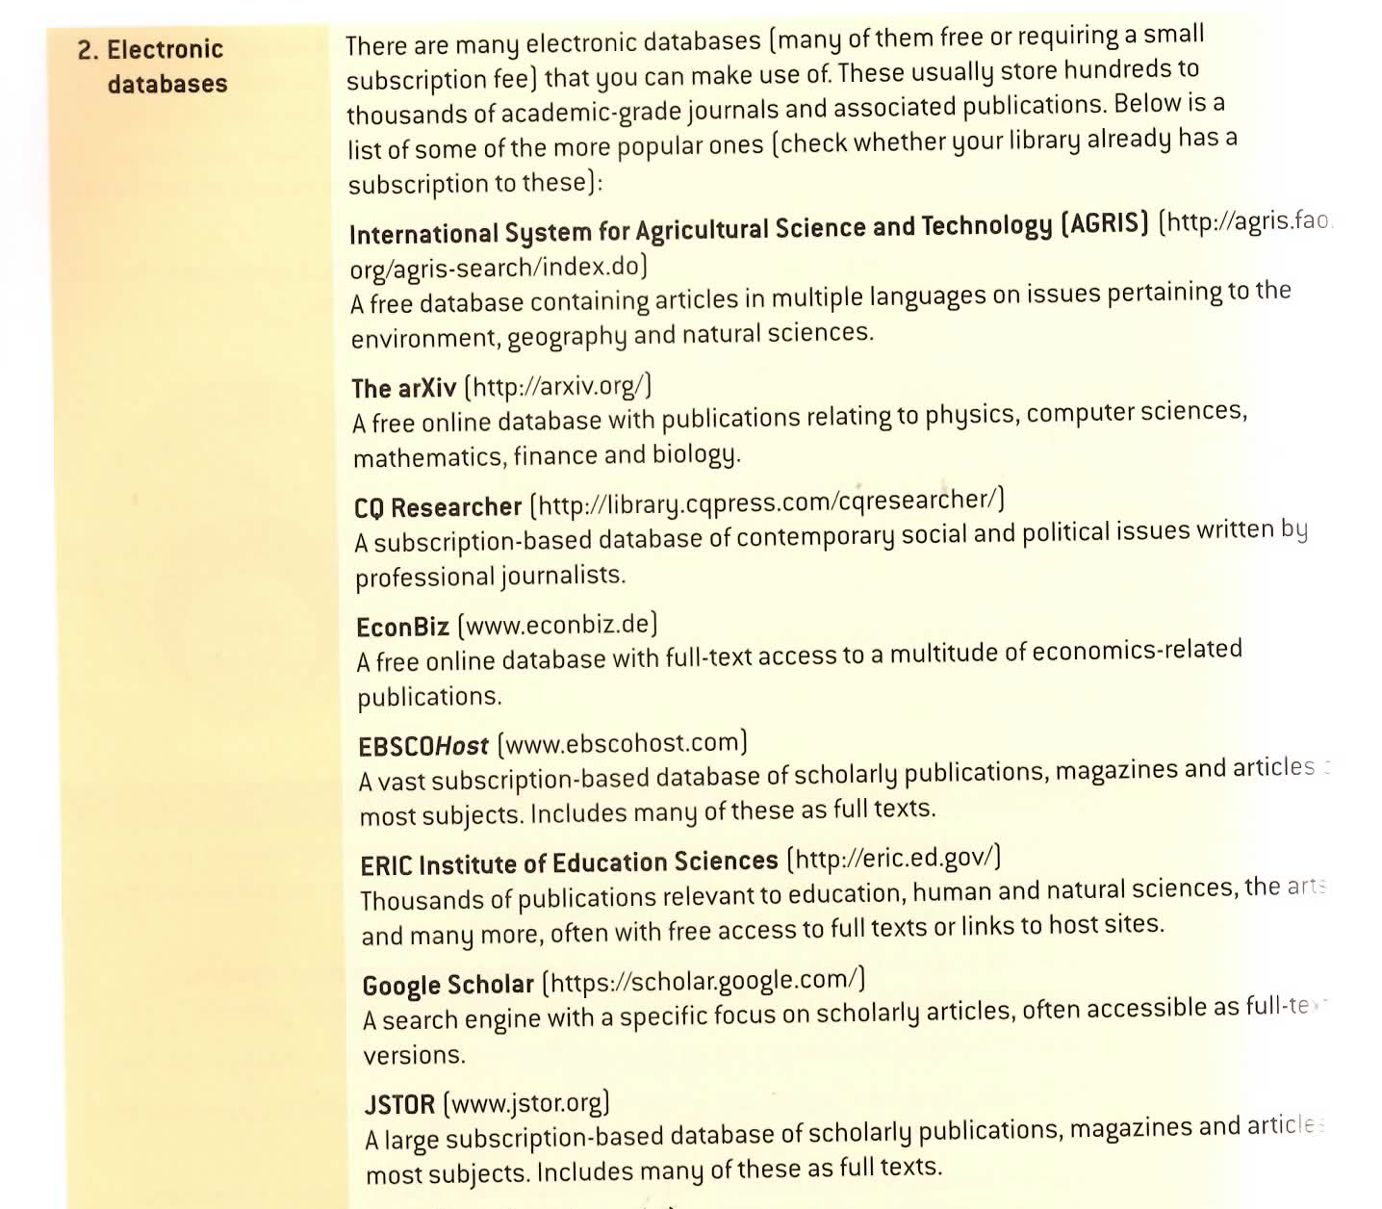
Electronic databases
Page 38 of your Extended Essay Course Companion includes a quick reference list which could be used in conjunction with the Cornish Resource Page.

Slide 6
Cornish Library & beyond
https://stleonardscollege.libguides.com/crcpage
Effective Google Searching
Using the Cornish Library catalogue
Deep Web and Beyond: More than Google
Periodicals & Newspapers
Alternative Library Resources
http://stleonardscollege.libguides.com/c.php?g=309386&p=5437350
CRAAP Test: Referencing - Cornish Library Resource Guides - LibGuides at St Leonard's College

Slide 7
Referencing
Which ever style you choose, you must stay consistent within your written piece.
APA 7th ed.
Footnote - MLA
Oxford
Other options
Warning: If your Extended Essay has no referencing or very unclear referencing, IB Australia have the option to send your paper to be read by Academic Integrity in Cardiff, Wales.

Slide 8
Writing a Bibliography
Why is it important to Reference?
Avoid Plagarism
Allows references to be confirmed
Shows depth of research
Gives credit to the Author.
http://stleonardscollege.libguides.com/c.php?g=309386&p=5437350
View: https://www.youtube.com/watch?v=pG7M4xxrmbo

Slide 9
Writing a Bibliography
APA 7th ed.
Book:
Author. (Year of Publication). Title. Where published, Country: Publisher.
Intext: (Author, Year of Publication)
Webpage:
Author. (Year of Publication). Title. Retrieved from URL.
Intext: (Author, Year of Publication)
Journal:
Author. (Year of Publication). Title of Article. Title of Periodical, Vol. No. (Issue No.), page nos.
Intext: (Author, Year of Publication)

Slide 10
Writing a Bibliography
APA 7th ed.
Creating in Word
  Top Toolbar
  Select “References”
  Change Style as necessary.
  Using Cornish Library pages to create Bibliography
  SLASA Online Referencing Generator
  SLASA Online Referencing Generator
  You can always refer to Pages 115 – 130 of Extended Essay textbook.
  View the film clips on Cornish Library page

Slide 11
Writing a Bibliography
Footnotes & Endnotes
Some styles of referencing prefer to use Footnotes (which appear at the end of the page) or Endnotes (which appear at the end of the paper).
MLA
Oxford
Chicago
Page 116 of your Textbook also contains some vital information.

Slide 12
Writing a Bibliography
Other tools to assist, available through Cornish Library:
Free citation software
Turnitin
Referencing tutorials
Your Library staff
(Lydia.Holmes@stleonards.vic.edu.au or Elizabeth.Paterson@stleonards.vic.edu.au)

Slide 13
Writing a Bibliography
Referencing the unusual
Interviews
Ephemera
Translated works
Government Documents
Personal Correspondence

Slide 14
That little bit extra
If using Apple Mac don’t use a Word Document use Pages.
Let us know your topic – specialist libraries are out there.
Start sooner rather than later
Ask for help.
Remember, correct formatting of paper is essential – do you have:
  Title Page
  Table of Contents
  Page Numbers
  Font (12 pt, bold for emphasis, capitals for heading)
  Spacing must be double spaced

Slide 15
That little bit extra
Record every item you read, ponder or which helps you form an idea. If the item is not used it can be deleted from your Bibliography/Reference List, but if it has not been noted it may be difficult to locate again.
Enjoy the research stage, remember this is a topic you have chosen!

