Slide 1
Ice Cream Headache Tim Sinclair
Connecting to subjectively make meaning from a text.

Slide 2
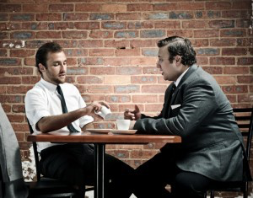
“Everyone understands a smile, don’t they?” (p. 65)
Personal connection: This reminds me of the time I worked in a café and two Irish gentlemen tried to place an order, but I couldn’t understand them because of their thick accents. Despite this, we were all able to laugh about the situation and the fact that it was so difficult to communicate.

Slide 3
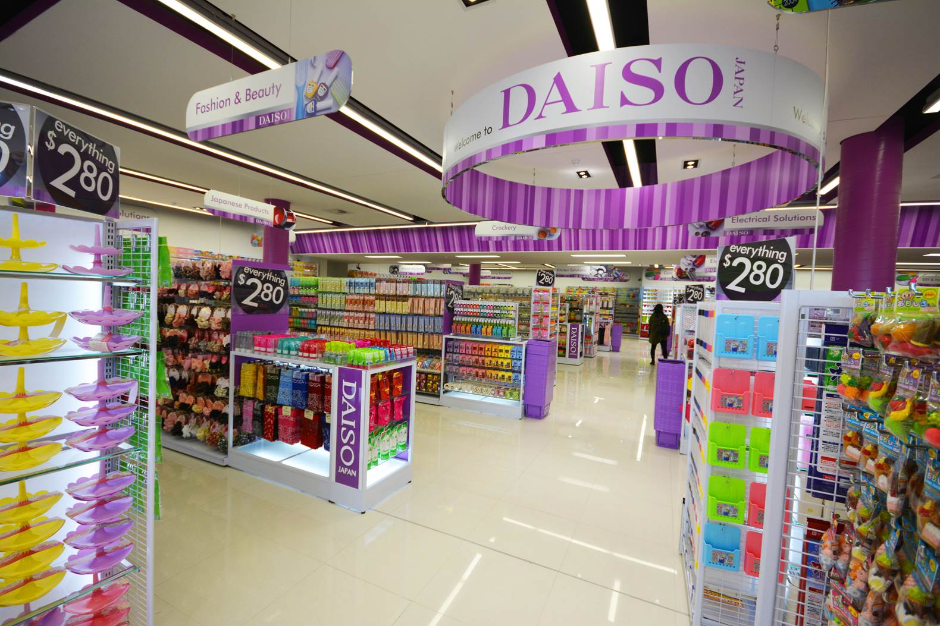
“…With its row upon row of Japanese snacks, and signs that scream in a language you can’t understand.” (p. 66)
Personal connection: This made me think of the Daiso store in Chadstone Shopping Centre, which is a Japanese discount shop. It has many products with little to no English writing on them – which can make buying them a bit of a gamble!

Slide 4
“Nothing is working out like you had planned.” (p. 66)
Lyrics:
It's coming round again
Slowly creeping hand
Of time and its command
Soon enough it comes
And settles in its place
Its shadow in my face
Puts pressure in my day
This life well it's slipping right through my hands
These days turned out nothing like I had planned
Intertextual connection: This made me think of the song ‘These Days’ by Powderfinger. The song describes feeling like you have no control over how things turn out, and how frustrating this can be.

Slide 5
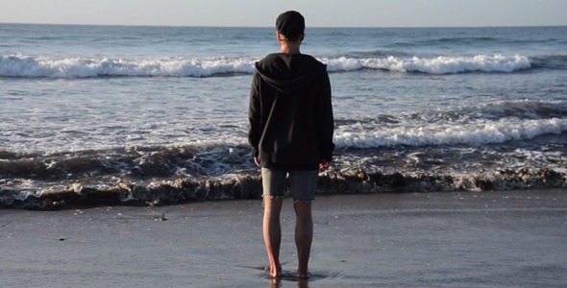
“You sat in a plane on the edge of Australia. The smooth edge, the straight edge, the runway concrete.” (p. 67)
Intertextual connection: This line reminds me of a section of the story ‘Out of the Yellow’, by James Roy. “This is where Australia ends and the rest of the world begins […] One more step and you’re off the edge of the map, out of the yellow and into the pale blue.” (p. 13) I think both quotations are talking about being on the cusp of something, not just in a geographical sense, but also in terms of personal experience and growth.

Slide 6
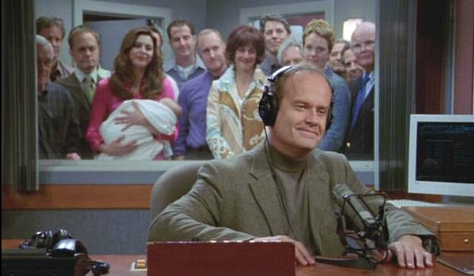
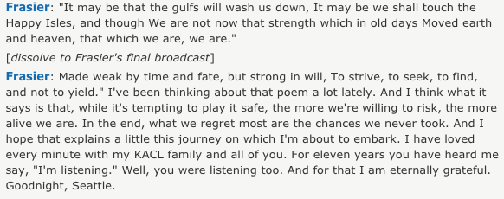
“Taxiing smoothly to the end of your life, ready to fly to another.” (p. 67)
Intertextual connection: This made me think of the final episode of the TV show Frasier, in which the main character, a radio presenter, decides to leave behind his life in Seattle and move interstate. I thought particularly of this quotation about taking chances as opposed to taking risks.

Slide 7
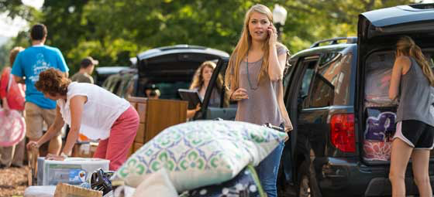
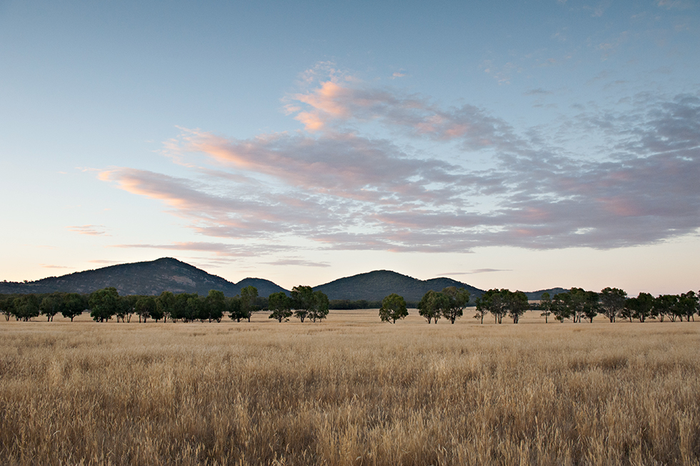
“You were leaving behind your everyday life […] You were flying away from a life that you wanted to change.” (p. 67)
Personal connection: This made me think of the experience of leaving home and the regional town in which I grew up to move to Melbourne for university. It made me connect to the different emotions that I felt at that time – excitement, apprehension, and also sadness that I was leaving my family.

Slide 8
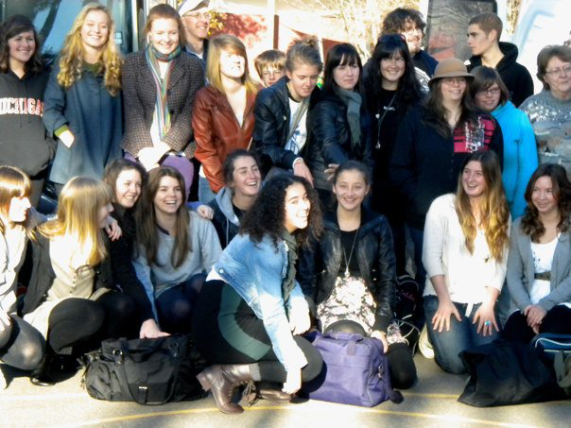
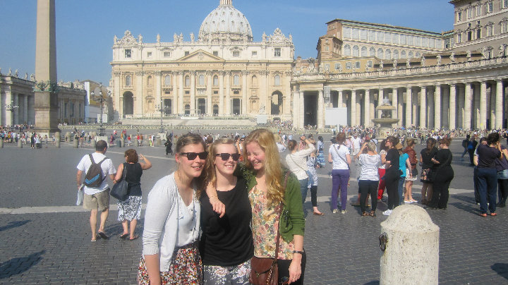
“You left in winter […] and now you stand sweating in a t-shirt and shorts.” (p. 68)
Melbourne (coat!)
Rome, straight after getting off the plane (note the bright red face!)
Personal connection: This made me think of getting on a plane in freezing cold, Melbourne July, and arriving in 35 degree Rome, realising I was wearing far too many layers!

Slide 9
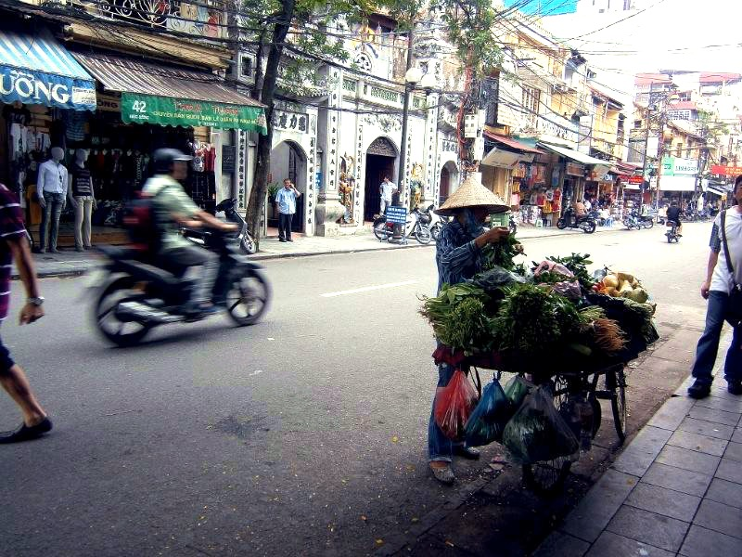
“There is too much noise, and too many smells, and the cars and the street are all somehow just different.” (p. 68)
Personal connection: This reminded me of this photograph I took in Vietnam, and how, to me, it represented feeling completely unsettled and alien to the place I was in. Sometimes now, I will smell something in Australia and be completely transported back to standing in this place in Vietnam, smelling the fragrant, different air.

