Slide 1
Body Systems Part 2
Endocrine System
FeedBack models

Slide 3
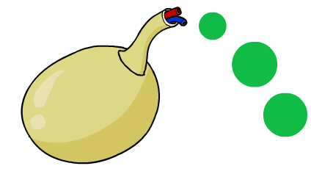

The hormonal system
The hormonal system also coordinate some of the body’s responses, using hormones.
Hormones are produced by glands. These chemicals are released into the blood where they are carried around the body. A response is produced when the hormone reaches its target organ.
gland
hormone
Hormonal responses are slower and longer lasting than those coordinated by the nervous system.
Hormones control growth and reproduction processes.

Slide 4

Hormone glands

Slide 6
The Endocrine System
Your endocrine system uses chemical messengers called hormones. They are produced in your endocrine glands and are released directly into your bloodstream.
Although hormones are carried to all parts of your body, only particular cells have receptors for particular hormones. It is a little like radio signals, which are sent out in all directions but picked up only by radios attuned to a particular signal.
These target cells are attuned to the hormones carried through your body and respond in a particular way.
Hormones control and regulate functions such as metabolism, growth, development and sexual reproduction.
The endocrine system detects a change in a variable, and often acts using a negative feedback mechanism to counteract the initial change. The endocrine system works with the nervous system to regulate your body’s responses to stress.
The effects of the endocrine system are usually slower and generally longer lasting than those of the nervous system.

Slide 7
The Big Picture
You are a multicellular organism made up of many cells that need to be able to communicate with each other. They need to be able to let other cells know when they need help and support, when they need more of something or when they need to get rid of something.
While one of your cells may be a part of one of the systems in your body, it may also need to communicate and interact with other systems to stay alive. It may depend on your digestive system to break down nutrients so that its chemical requirements are in a form that can be used, and your circulatory system to deliver these. Your respiratory system will also be involved in ensuring a supply of oxygen and removal of carbon dioxide.
Other organs in the excretory system will also be involved in removing wastes that may otherwise be toxic.
Your systems need to work together so that a comfortable stable environment for the cells is maintained.

Slide 8
Homeostasis
The internal environment in which your cell lives needs to be kept constant. Temperature, pH and concentrations of ions, glucose, water and carbon dioxide need to be within a particular range.
Maintenance of this constant internal environment is called homeostasis.
To be able to achieve homeostasis, any changes or variations (stimuli) in the internal environment need to be detected (by receptors).
If a response is required, this needs to be communicated to effectors to bring about some type of change or correction so the conditions can be brought back to normal. This is described as a stimulus–response model.

Slide 9
Negative Feedback Loops
Stimulus–response models can also involve negative or positive feedback.
Most biological feedback systems involve negative feedback.
Negative feedback reactions are those in which the response is in an opposite direction to the stimulus.
For example, if levels of a particular chemical in the blood were too high, then the response would be to lower them and if the levels were too low, then they would be increased.

Slide 10
Positive Feedback Loops
Positive feedback reactions, keep the response going in the same direction.
It has a positive effect on the stimulus.
An example of a positive feedback reaction occurs when a mother is
breastfeeding her baby.
Another example involves the stimulation of uterine contractions during childbirth.

Slide 11
Nervous System and Endocrine System Working Together
Both of these systems require signalling molecules to communicate messages throughout the body, they have different ways of going about it.
The nervous system involves the message being sent as a nervous or electrical impulse along a neuron and then as a chemical message (neurotransmitter) across the gaps (synapses) between them.
The endocrine system uses only chemical messages (hormones) transported throughout the circulatory system to its target cell.

Slide 12
Nervous System and Endocrine System Working Together
The control of body temperature, referred to as thermoregulation, provides an example of the nervous and endocrine systems working together.
Evidence suggests that a part of your brain called the hypothalamus contains a region that acts as your body’s thermostat.
It contains thermoreceptors that detect the temperature of blood that flows through it.
If your body temperature increases or decreases from within a particular range, messages from thermoreceptors in your skin or hypothalamus trigger your hypothalamus to send messages to appropriate effectors to bring about a response that will correct it.

Slide 13
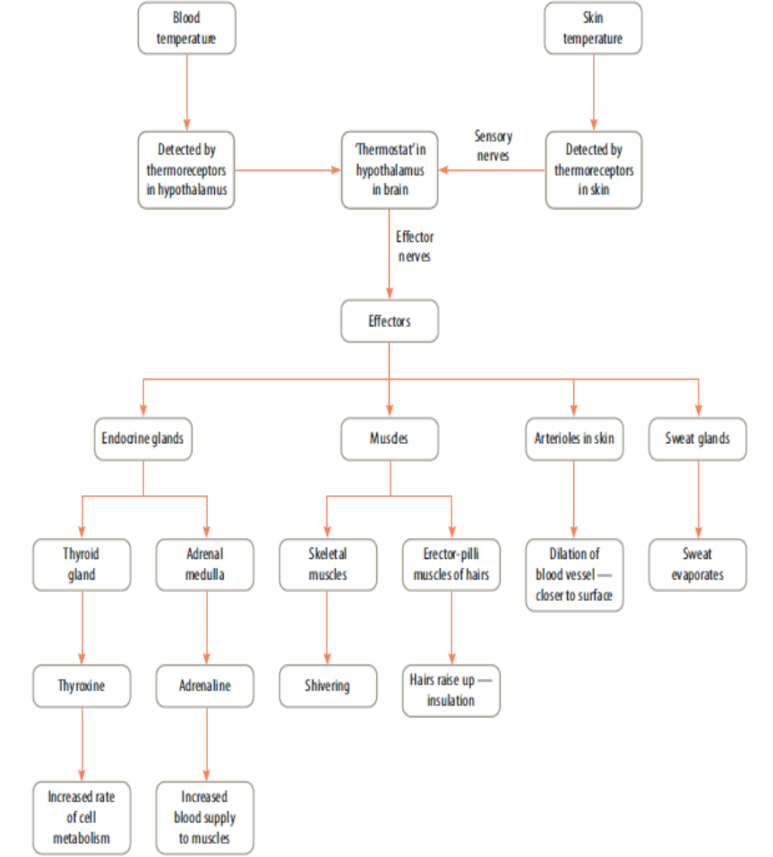

Slide 14
Negative Feedback- Thermoregulation
Negative feedback helps our body to keep its internal conditions stable so that you can function effectively.
An example of this is if your body temperature is too low.
The decrease in body temperature acts as the stimulus, which is detected by thermoreceptors in your body.
This message is taken to the hypothalamus, which activates warming mechanisms.
One of these mechanisms involves the thyroid gland. It responds by secreting the hormone thyroxine, which increases the metabolic rate of cells, releasing heat to warm you.
Raising body temperature reduces the need for the hypothalamus to direct the thyroid gland to secrete thyroxine.

Slide 15
Negative Feedback -Glucose Regulation
Insulin, a hormone produced by your pancreas, acts on target cells in the liver.
After you have eaten a lot of sugary food, your blood glucose (or blood sugar) level rises. The rise is detected by cells in the pancreas.
The pancreas then secretes insulin, which travels through the bloodstream to the liver. Specific target cells respond by converting glucose from your blood into glycogen, which is then stored. This has the effect of lowering the amount of glucose in your blood.
Another hormone, glucagon, also produced by your pancreas, has the opposite effect and raises your blood glucose levels.

Slide 16
Controlling Glucose levels
Your cells also need an exact level of glucose in the blood.
Excess glucose gets turned into glycogen in the liver
This is regulated by 2 hormones (chemicals) from the pancreas called:
Insulin
Glucagon

Slide 17
Glycogen
If there is too much glucose in the blood, Insulin converts some of it to glycogen
Insulin
Glucose in the blood

Slide 18
Glycogen
If there is not enough glucose in the blood, Glucagon converts some glycogen into glucose.
Glucagon
Glucose in the blood

